Slide 1
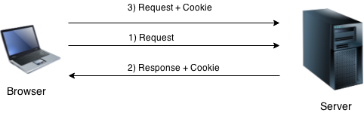
Cookies in JSP
Cookie is a small piece of information which is stored at client browser. It is used to recognize the user.
Cookie is created at server side and saved to client browser.
First time when client sends request to the server, then server embedded the cookie along with Response.
Next time onwards client sends request along with cookie to the server. Such way, cookie can be received at the server side.

Slide 2
Cookies are text files stored on the client computer and are used to store information.
There are given some commonly used methods of the Cookie class.
Method | Description
setMaxAge(int expiry) | Sets the maximum age of the cookie in seconds.
String getName() | Returns the name of the cookie.
String getValue() | Returns the value of the cookie.
void setName(String name) | sets the name of the cookie.
void setValue(String value) | sets the value of the cookie.
void addCookie(Cookie ck) | used to add cookie in response object.
Cookie[] getCookies() | used to return all the cookies from the browser.

Slide 3
Create Cookie:
The following code shows how to create a cookie
Cookie ck=new Cookie("user",”abcd"); //creating cookie object
response.addCookie(ck); //adding cookie in the response
Get Cookie:
The following code shows how to get all cookies
Cookie ck[ ]=request.getCookies(); //get cookie values
Delete Cookie:
The following code shows how to delete a cookie
Cookie ck=new Cookie("user","");//deleting value of cookie
ck.setMaxAge(0);//changing the maximum age to 0 seconds
response.addCookie(ck);//adding cookie in the response

Slide 4
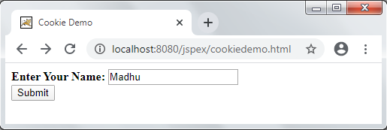
Example:
cookiedemo.html
<html>
<head>
<title>Cookie Demo</title>
</head>
<body>
<form method="post" action="setcookie.jsp">
<p><b>Enter Your Name: </b>
<input type="text" name="username"><br>
<input type="submit" value="Submit">
</form>
</body>
</html>

Slide 5
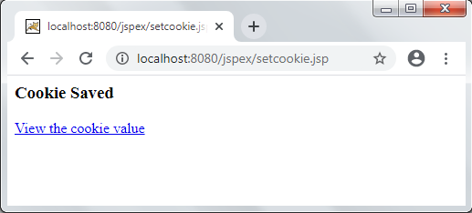
setcookie.jsp
<%
String uname=request.getParameter("username");
Cookie ck = new Cookie ("username",uname);
ck.setMaxAge(1* 60);
response.addCookie(ck);
%>
<html>
<body>
<h3>Cookie Saved</h3>
<p><a href="showcookie.jsp“>View the cookie value</a><p>
</body>
</html>

Slide 6
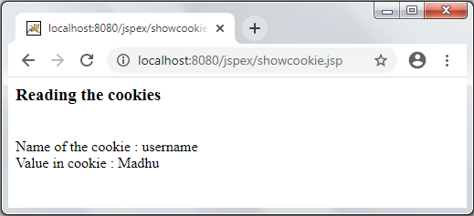
showcookie.jsp
<html>
<body>
<h3>Reading the cookies</h3>
<%
Cookie[] array= request.getCookies();
for(int i=0; i<array.length; i++)
{
if(array[i].getName().equals("username"))
{
out.println("<br/>");
out.println("Name of the cookie : " + array[i].getName() + "<br/>");
out.println("Value in cookie : " + array[i].getValue());
}
}
%>
</body>
</html>

