Slide 1
Connecting to Database in JSP
All the web applications usually interact with different types of databases. Databases are basically used to store various types of information for different purposes.
JSP pages are looks like regular html pages with the inclusion of dynamic behavior.
JSP pages allows the developer to interact with database by using JDBC code.
By using Scriptlets, we can include database programming (JDBC code) in JSP.

Slide 2
The Architecture of accessing a database by using JSP.
Web Browser
(IE,Chrome..)
Http
Requests
Response in HTML
Tomcat Application Server
JDBC
Requests
Responses
Database
Fig: 3-tier Architecture

Slide 3
For Database Connectivity we write the following code in jsp page.
Open Connectivity Code:
<%@page language=“java” import=“java.sql.*”%>
<%
// Load driver class file of Oracle
class.forName(“oracle.jdbc.driver.OracleDriver”);
Connection con=DriverManager.getConnection(
"jdbc:oracle:thin:@localhost:1521:xe","system","password");
// Load driver class file of MySql
class.forName(“com.mysql.jdbc.Driver”);
Connection con=DriverManager.getConnection(
" jdbc:mysql://localhost:3306/TestDb",“root",“root");
%>

Slide 4
Statement Code:
<%
// Create the statement
Statement stmt=conn.CreateStatement();
String query=“SELECT * from students”
stmt.executeQuery(query);
%>
Close connectivity Code:
<%
// Close the Statement
stmt.close();
// Close the connection
conn.close();
%>

Slide 5
Example: Registration.html
<html >
<head> <title>Registration</title> </head>
<body>
<form action="reg.jsp" method="post">
Email :<input type="text" name="email" /><br/>
First name :<input type="text" name="fname" /><br/>
Last name :<input type="text" name="lname" /><br/>
User name :<input type="text" name="userid" /><br/>
password :<input type="password" name="pwd" /><br/>
<input type="submit" />
</form>
</body>
</html>

Slide 6
reg.jsp
<%@ page import ="java.sql.*" %>
<%@ page import ="javax.sql.*" %>
<%
String user=request.getParameter("userid");
String pwd=request.getParameter("pwd");
String fname=request.getParameter("fname");
String lname=request.getParameter("lname");
String email=request.getParameter("email");
Class.forName("oracle.jdbc.driver.OracleDriver");
Connection con = DriverManager.getConnection ("jdbc:oracle:thin:@localhost:1521:xe","system","system");
Statement st= con.createStatement();
String query="insert into users values ('"+user+"','"+pwd+"','"+fname+"','"+lname+"','"+email+"')“;
st.executeUpdate(query);
st.close();
con.close();
out.println("registration successfull");
%>

Slide 7
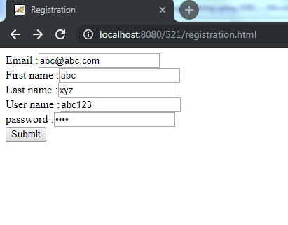
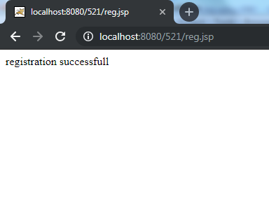
Output:

