Slide 1
Density–Based Methods
(DBSCAN Algorithm)

Slide 2
Density-based clustering is an unsupervised learning algorithm that groups similar data points in a dataset based on their density.
Where the density refers the number of data points within a specified radius (epsilon ε) of a given data point.
The most popular density-based clustering algorithm is DBSCAN (Density-Based Spatial Clustering of Applications with Noise).

Slide 3
Why Density-based clustering ?
We have seen in the partitioning clustering (eg: K-means) there are a predetermined number of clusters, and hierarchical clustering forms the clusters along with all data points.(i.e. including noise / outliers).
To solve the above challenges, we can opt for the Density-based clustering algorithm because, in this algorithm, we do not need to have knowledge about the predefined number of clusters and It ignores the noise or outlier data points.

Slide 4
DBSCAN Algorithm
(Density-Based Spatial Clustering of Applications with Noise).

Slide 5
One commonly used density-based clustering algorithm is DBSCAN (Density-Based Spatial Clustering of Applications with Noise).
DBSCAN groups the data points that are close to each other based on a distance measure and a density threshold.
It can discover clusters of different shapes and sizes from a large amount of data, which is containing noise and outliers.

Slide 6
The DBSCAN algorithm uses two parameters:
• eps (ε): The epsilon parameter defines the radius of the neighbors around a datapoint x. (or) It is a distance measure that will be used to locate the points in the neighborhood of any point.
• MinPts: The MinPts parameter is the minimum number of neighbors (threshold) within the “eps” radius.
In density-based clustering, the number of clusters does not need to be predetermined, but the values of MinPts and eps do.

Slide 7
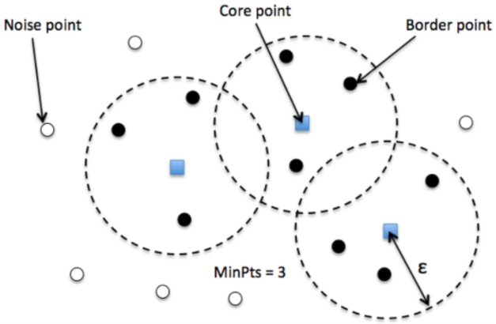
In the DBSCAN algorithm, there are three types of points: core points, border points, and noise points.

Slide 8
Core point: A core point is a point that has at least MinPts within its epsilon neighbourhood. In other words, a core point has enough nearby neighbours to be considered as part of a cluster.
Border point: A border point is a point that is not a core point, but it is within the epsilon neighbourhood of a core point. Border points can be considered as part of a cluster, but they are not as strongly connected to the cluster as core points.
Noise point: A noise point is a point that does not have any core points within its epsilon neighbourhood. Noise points are often considered outliers and are not part of any cluster.

Slide 9
DBSCAN algorithm:
Here are the steps involved in the DBSCAN algorithm:
Step -1: First, define epsilon and identify MinPts.
Step -2: Starting with a core point, the algorithm finds all the points within its epsilon neighbourhood(radius) and assigns them to the same cluster. It then repeats this process for each core point and continues to add points to the same cluster as long as they are within epsilon distance of another point in the cluster.

Slide 10
Step -3: Identify border points: A border point is a point that has fewer than MinPts within its epsilon neighbourhood, but is reachable from a core point. These points are often considered part of a cluster but can also be considered noise.
Step-4: Output clusters: The algorithm outputs the clusters that have been identified.

Slide 11
The advantages of DBSCAN algorithm:
Density-based clustering algorithms can handle noisy data since they can identify noise points as outliers that do not belong to any cluster.
Unlike some other clustering algorithms, density-based clustering can identify clusters of different shapes and sizes, including irregularly shaped clusters.
They don’t require prior knowledge of the number of clusters, making them more flexible and versatile.
They can efficiently process large datasets and handle high-dimensional data.

Slide 12
The disadvantages of DBSCAN algorithm:
The performance of density-based clustering algorithms is highly dependent on the choice of parameters, such as epsilon ε and MinPts, which can be challenging to tune.
They can be computationally expensive and time-consuming, especially for large datasets with complex structures.

Slide 13
Example: Apply the DBSCAN algorithm to given data points and create the clusters with
MinPts = 3 and epsilon = 1.9.
Data points:
P1: (3,7)
P2: (4,6)
P3: (5,5)
P4: (6,3)
P5: (7,3)
P6: (6,2)
P7: (3,3)

Slide 14
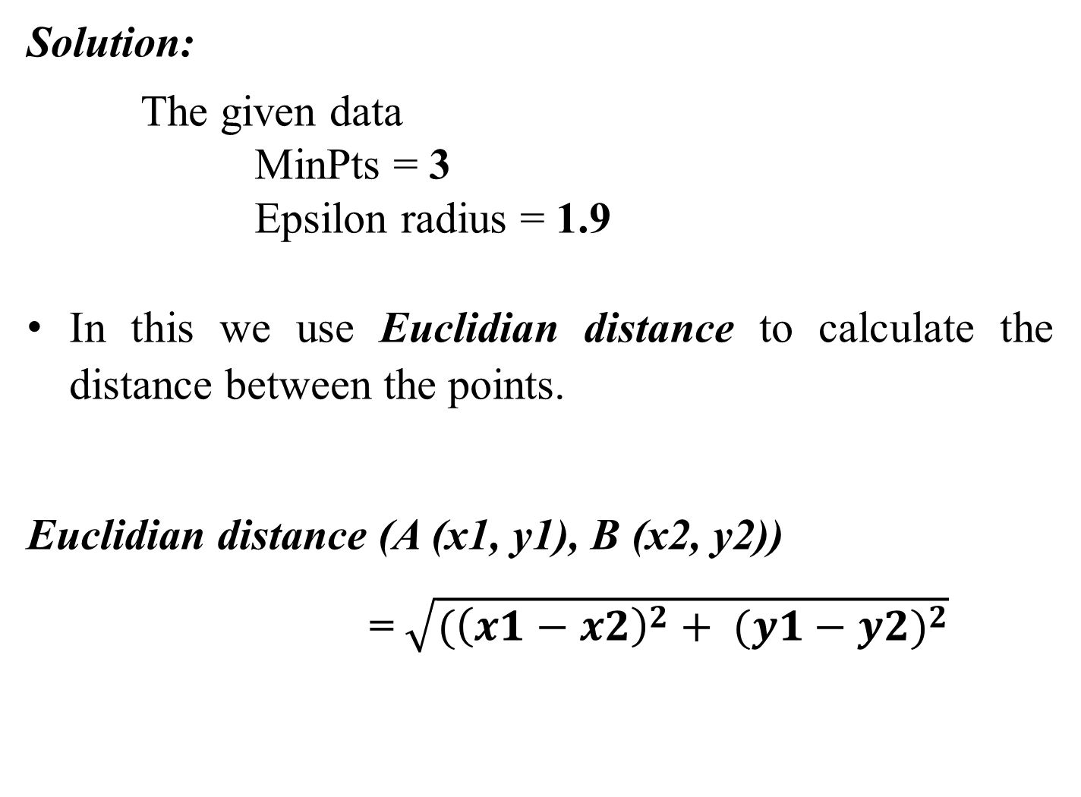
Solution:
The given data
MinPts = 3
Epsilon radius = 1.9
In this we use Euclidian distance to calculate the distance between the points.
Euclidian distance (A (x1, y1), B (x2, y2))
= $\sqrt{({\left(x1−x2\right)}^{2}+ {(y1−y2)}^{2}}$

Slide 15
Now, Calculate the distance(Euclidian) from each point to all the data points.
 |  |  | P1 | P2 | P3 | P4 | P5 | P6 | P7
P1: (3,7) |  | P1 | 0
P2: (4,6) |  | P2 | 1.41 | 0
P3: (5,5) |  | P3 | 2.83 | 1.41 | 0
P4: (6,3) |  | P4 | 5.00 | 3.60 | 2.23 | 0
P5: (7,3) |  | P5 | 5.66 | 4.24 | 2.83 | 1.00 | 0
P6: (6,2) |  | P6 | 5.83 | 4.47 | 3.16 | 2.00 | 1.00 | 0
P7: (3,3) |  | P7 | 4.00 | 3.16 | 2.83 | 3.00 | 4.00 | 3.16 | 0

Slide 16
Next, find the nearest data points for each data point are:
minPts = 3 and epsilon = 1.9
 | P1 | P2 | P3 | P4 | P5 | P6 | P7 | Nearest Datapoints
P1 | 0 |  |  |  |  |  |  | P1: P2
P2 | 1.41 | 0 |  |  |  |  |  | P2: P1,P3
P3 | 2.83 | 1.41 | 0 |  |  |  |  | P3: P2
P4 | 5.00 | 3.60 | 2.23 | 0 |  |  |  | P4:P5
P5 | 5.66 | 4.24 | 2.83 | 1.00 | 0 |  |  | P5:P4,P6
P6 | 5.83 | 4.47 | 3.16 | 2.00 | 1.00 | 0 |  | P6:P5
P7 | 4.00 | 3.16 | 2.83 | 3.00 | 4.00 | 3.16 | 0 | P7

Slide 17
Once the calculate nearest data points, we need to find the Core, Border and Noise data points.
 | minPts = 3 and epsilon = 1.9
 |  | Point | Status
P1: P2 |  | P1 | Noise
P2: P1,P3 |  | P2 | Core
P3: P2 |  | P3 | Noise
P4:P5 |  | P4 | Noise
P5:P4,P6 |  | P5 | Core
P6:P5 |  | P6 | Noise
P7 |  | P7 | Noise

Slide 18
Once the calculate nearest data points, we need to find the Core, Border and Noise data points.
 | minPts = 3 and epsilon = 1.9
 |  | Point | Status
P1: P2 |  | P1 | Noise | Border
P2: P1,P3 |  | P2 | Core
P3: P2 |  | P3 | Noise | Border
P4:P5 |  | P4 | Noise | Border
P5:P4,P6 |  | P5 | Core
P6:P5 |  | P6 | Noise | Border
P7 |  | P7 | Noise

Slide 19
From the above,
P2 and P5 are Core data points
P1, P3, P4 and P6 are Border data points
P7 is Noise (or) Outlier data point.
There are two core data points that means there are two clusters.
Those are
Cluster-1: (P2: P1, P3)
Cluster-2: (P5: P4, P6)

Slide 20
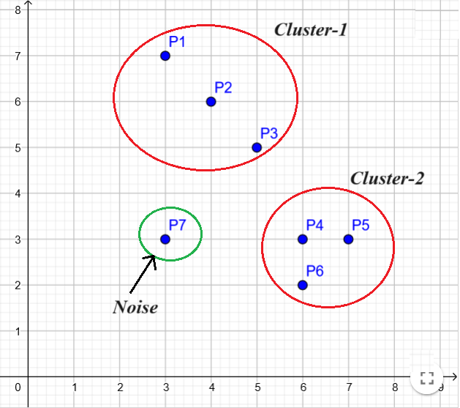
Now, try to draw clusters on 2D space.

Slide 21
