Slide 1
Decision Tree Induction

Slide 2
What is Decision Tree?
Decision Tree is a type of data mining technique that is used to build Classification Models. It builds classification models in the form of a tree-like structure, just like its name.
A decision tree is a flowchart-like tree structure, where each internal node (non-leaf node) denotes a test on an attribute, each branch represents an outcome of the test, and each leaf node (or terminal node) holds a class label.
The topmost node in a tree is the root node. It represents the best attribute selected for classification.

Slide 3
Example:
The following is a typical decision tree. It represents the concept buys_computer, that is, it predicts whether a customer is likely to purchase a computer.
age ?
In Decision tree,
- Internal nodes are denoted by rectangles,
- leaf nodes are denoted by ovals
youth
senior
middle_aged
student ?
credit_rating ?
yes
yes
no
fair
excellent
yes
no
yes
no
According to the decision tree provided above, the tuple (age = senior, credit_rating = excellent) is associated to the class label (buys_computer = yes).

Slide 4
Decision Tree Induction
In 1980, J. Ross Quinlan, a researcher, created the ID3 (Iterative Dichotomiser) algorithm, which is a decision tree algorithm. Later on, he introduced C4.5, which was the successor of ID3.
In 1984,a group of authors published the book Classification and Regression Trees (CART),which described the generation of binary decision trees.
ID3 and CART were invented independently of one another at around the same time, yet follow a similar approach for creating decision trees from training tuples(Dataset).

Slide 5
Decision Tree Algorithm:
Aim :
Generate a decision tree from the training data partition(D).
Input:
Data partition(D) - which is a set of training tuples and their associated class labels;
attribute_list: - the set of candidate attributes;
Attribute_selection_measure - describes the method for selecting the best attribute for discrimination among tuples.
Output:
A decision tree.

Slide 6
Decision Tree Algorithm:
Method :
Step-1: Begin the tree with the root node, says R, which contains the complete dataset D.
Step-2: Find the best attribute in the dataset using Attribute Selection Method (ASM).
Step-3: Divide the dataset(D) into subsets that contains possible values for the best attribute.
Step-4: Generate the decision tree node, which contains the best attribute.
Step-5: Recursively make new decision trees using the subsets of the dataset created in step -3. Continue this process until reaches leaf nodes.

Slide 7
Example: Suppose there is a person who has a job offer and wants to decide whether he should accept or decline the offer. Solve this problem, using the decision tree.
Input:
attribute_list:
Salary, Distance and Cab_facility.
class_labels:
Accept, Decline.

Slide 8
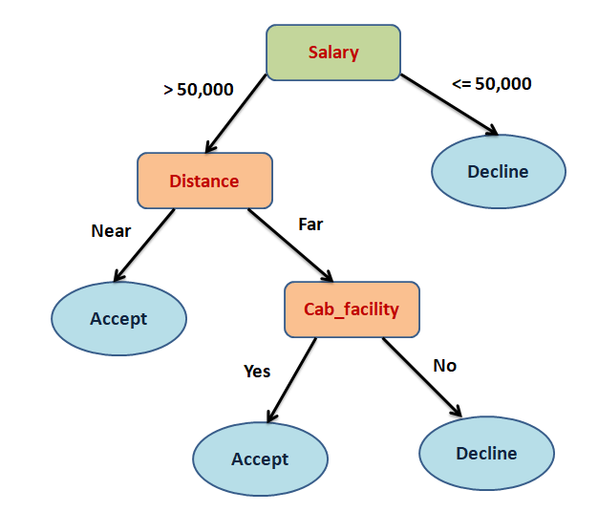
Output:
Method:
The decision tree starts with the root node (Salary).
The root node splits further into the next decision node (Distance attribute) and one leaf node(Decline).
The next decision node further gets split into one decision node (Cab_facility attribute) and one Accept .
Finally, the decision node(Cab_facility attribute) splits into two leaf nodes (Accept and Decline).

Slide 9
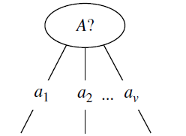
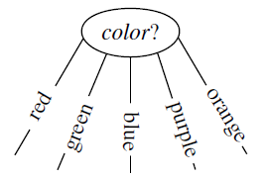
Splitting criterion: The splitting criterion tells us the “best” way to separate or partition the tuples in dataset (D) into individual classes.
Let A be the splitting attribute,
(a) If A is discrete-valued, then one branch is grown for each known value of A.

Slide 10
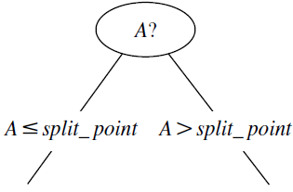
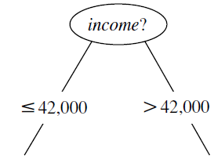
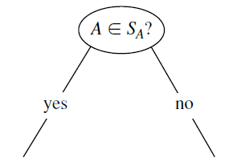
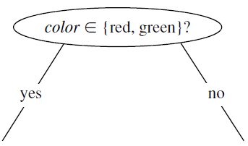
If A is continuous-valued, then two branches are grown, corresponding to A <= split_point and A > split_point.
If A is discrete-valued and a binary tree must be produced, then the test is of the form A Ꜫ S, where S is the splitting subset for A.

Slide 11
Attribute Selection Measures:
When implementing a Decision tree, the primary challenge is to choose the most suitable attribute for the root node and sub-nodes.
However, there is a technique known as Attribute selection measure that can help resolve such issues.
The following are the most common Attribute selection measures,
  - Entropy
  - Information Gain

Slide 12
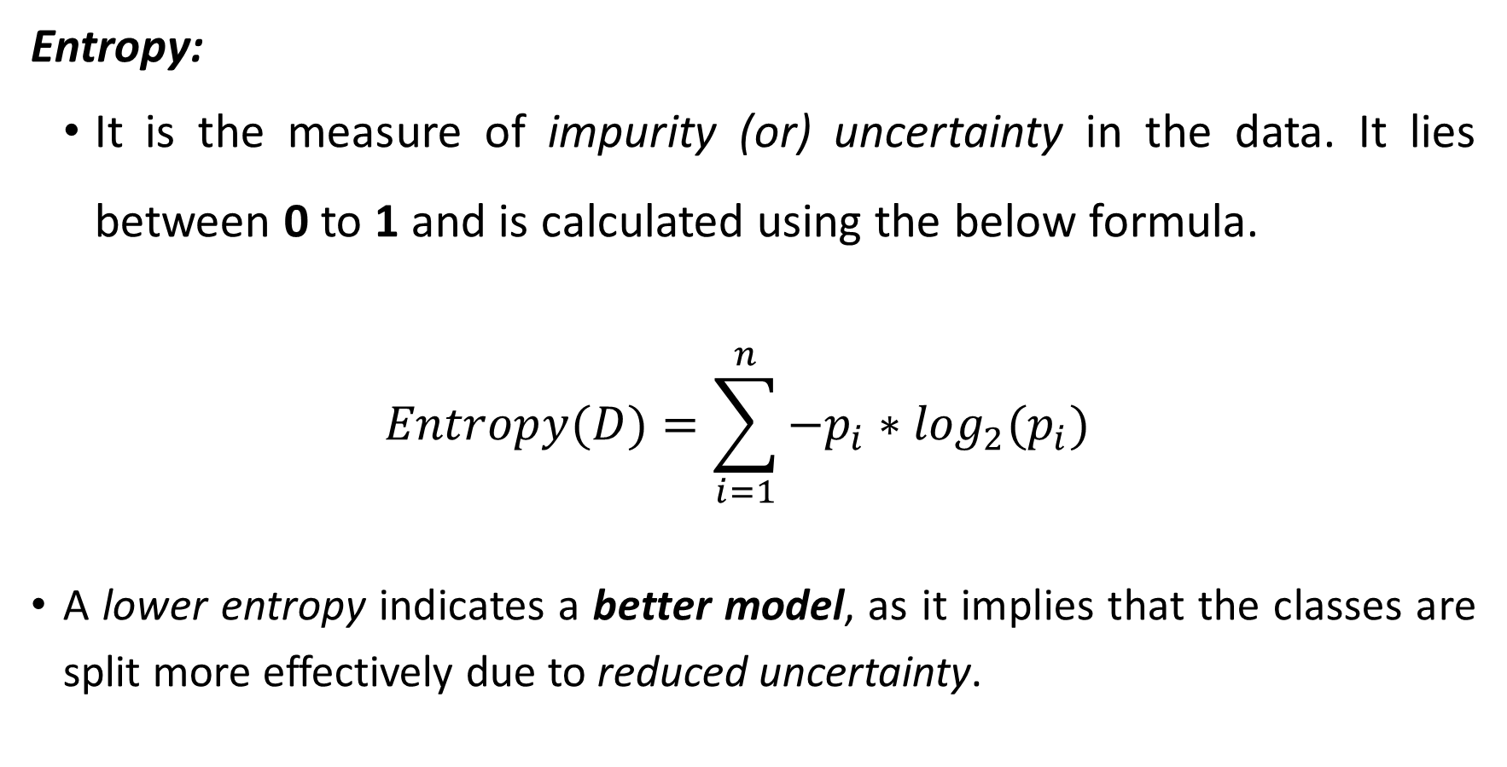
Attribute Selection Measures:
Entropy:
It is the measure of impurity (or) uncertainty in the data. It lies between 0 to 1 and is calculated using the below formula.
$$Entropy(D)=\sum_{i=1}^{n}{−p_{i}∗\log_{2}(p_{i})}$$
A lower entropy indicates a better model, as it implies that the classes are split more effectively due to reduced uncertainty.

Slide 13
For example, let us see the formula for a use case with 2 classes- Yes and No.
Entropy(D) = −P(Yes)*log2(P(Yes)) − P(No)*log2(P(No))
Here,
Yes and No are two classes ,
D is the total number of samples,
P(Yes) is the probability of Yes,
P(No) is the probability of No.
If there are many classes then the formula is
Entropy(D) = −P1*log2(P1) − P2*log2(P2) − ....... − Pn*log2(Pn)
Here n is the number of classes.

Slide 14
Attribute Selection Measures:
Information Gain:
This method is the main method that is used to build decision trees.
It reduces the number of tests that are needed to classify the given tuple.
The attribute with the highest information gain is selected.
Information gain is basically measuring the change in entropy.

Slide 15
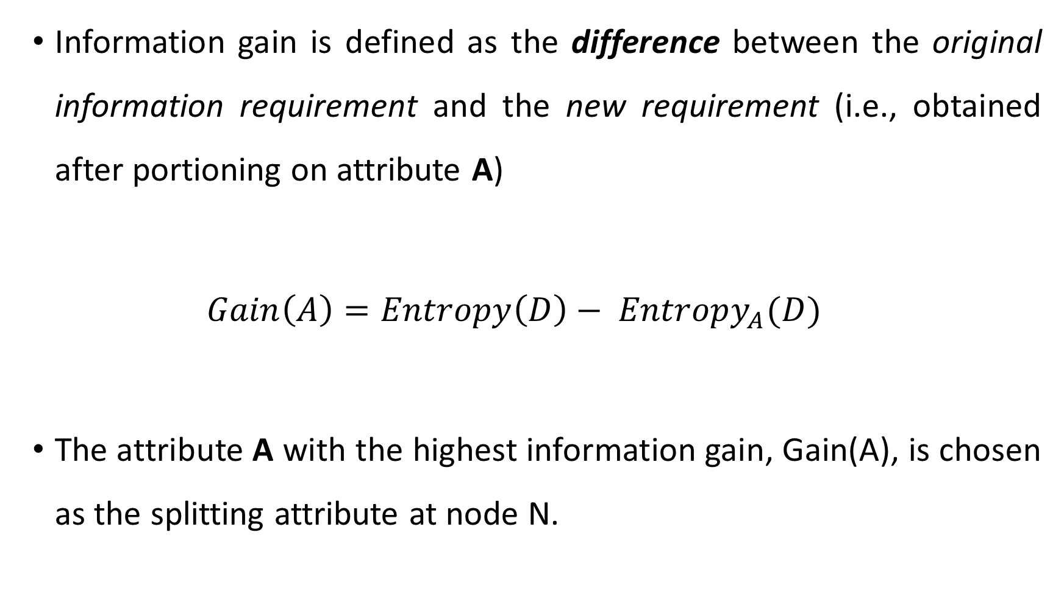
Information gain is defined as the difference between the original information requirement and the new requirement (i.e., obtained after portioning on attribute A)
$${Gain\left(A\right)=Entropy\left(D\right)− Entropy}_{A}(D)$$
The attribute A with the highest information gain, Gain(A), is chosen as the splitting attribute at node N.

Slide 16
Example:
Let us illustrate the ID3 algorithm with a simple example of classifying whether customer buys a computer based on some conditions.
(or)
Construct a decision tree to classify “buys_computer.”

Slide 17
Consider the following dataset:
Table-1: customer dataset
age | income | student | credit_rating | buys_computer
youth | high | no | fair | no
youth | high | no | excellent | no
middle_aged | high | no | fair | yes
senior | medium | no | fair | yes
senior | low | yes | fair | yes
senior | low | yes | excellent | no
middle_aged | low | yes | excellent | yes
youth | medium | no | fair | no
youth | low | yes | fair | yes
senior | medium | yes | fair | yes
youth | medium | yes | excellent | yes
middle_aged | medium | no | excellent | yes
middle_aged | high | yes | fair | yes
senior | medium | no | excellent | no

Slide 18
In the given customer dataset, we have 5 attributes/columns, those are age, income, student, credit_rating, and buys_computer.
In which age, income, student, credit_rating attributes are categorized as input features and where as buys_computer categorized as output/target feature.
Here, we are going to classify whether customer buys a computer or not based on the input features. And we will be going to use ID3 algorithm for building decision tree.

Slide 19
Solution:
To create a decision tree, First we need to select best attribute for root node.
To select best attribute , we will use Attribute Selection Measures, those are Entropy and Information Gain measures.
First, we need to count the number of “yes” and “no” for output column / feature called “buys_computer.”
There are “no” = 5 and “yes” = 9 (i.e., Total number of tuples = 14 )

Slide 20
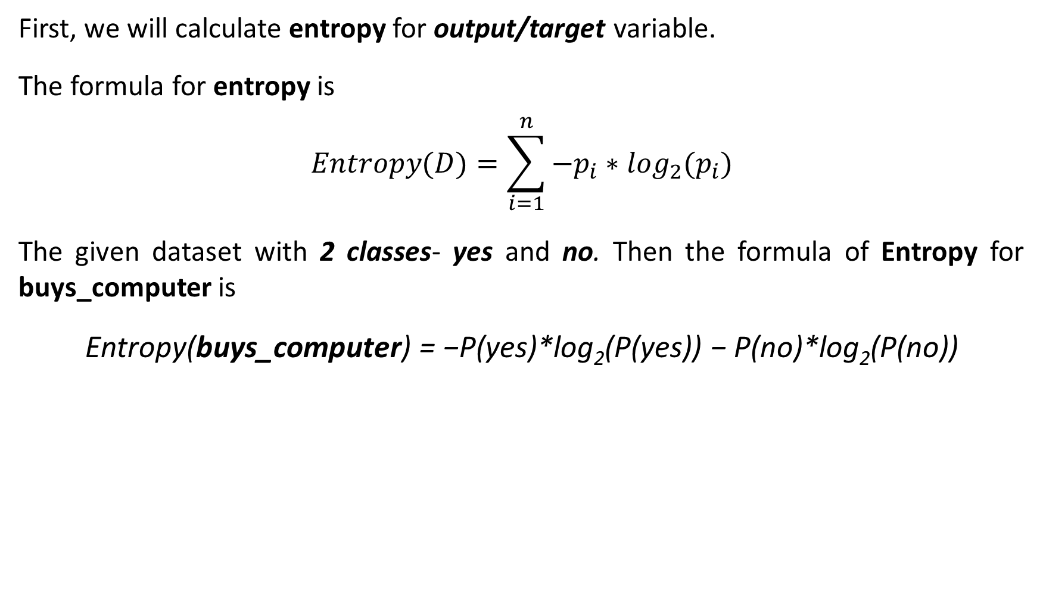
First, we will calculate entropy for output/target variable.
The formula for entropy is
$$Entropy(D)=\sum_{i=1}^{n}{−p_{i}∗\log_{2}(p_{i})}$$
The given dataset with 2 classes- yes and no. Then the formula of Entropy forbuys_computeris
Entropy(buys_computer) = −P(yes)*log₂(P(yes)) − P(no)*log₂(P(no))
P(yes) = p(yes) / (p(yes) + p(no))
= 9 / ( 9 + 5)
= 9/14
for “yes” component of buys_computer.
P(no) = p(no) / (p(yes) + p(no))
= 5 / (9 + 5)
= 5 /14
for “no” component of buys_computer.

Slide 21
Let us substitute the values in the entropy formula,
Entropy(buys_computer) = − (9/14) *log2(9/14) –(5/14) *log2(5/14)
= − (0.64) *log2(0.64) –(0.36) *log2(0.36)
= 0.412 + 0.53
= 0.94 bits.
Once we are ready with the Entropy of target variable, we will find out the Entropy for each column/variable/attribute with respect to target variable.
Entropy (buys_computer) = 0.94 bits

Slide 22
Let’s starts with the age column. Extract the age column from given dataset
So, here we can see that
youth has 2 yes, and 3 no
middle_aged has 4 yes and 0 no
senior has 3 yes and 2 no.
 |  | buys_computer
 |  | yes | no
age | youth | 2 | 3 | 5
 | middle_aged | 4 | 0 | 4
 | senior | 3 | 2 | 5
 |  |  |  | 14

Slide 23
Now we can calculate the Entropy for each value of age column.
Entropy(youth) = − (2/5) *log2(2/5) – (3/5) *log2(3/5)
= 0.97
Entropy(senior) = − (3/5) *log2(3/5) –(2/5) *log2(2/5)
= 0.97
Entropy(middle_aged) = − (4/4) *log2(4/4) –(0/4) *log2(0/4)
= 0.0
The Entropy of middle_aged is 0 i.e., middle_aged has only “yes” component.

Slide 24
So, once we are ready with Entropy for each value in age column then we will find out the Entropy for complete age column with respect to buys_computer column.
Entropy (buys_computer, age) =
P(youth) * E(youth) + P(middle_aged) * E(middle_aged) + P(senior) * E(senior)
= (5/14) * 0.97 + (4/14) * 0 + (5/14) * 0.97
= 0.693 bits
Entropy (buys_computer, age) = 0.693 bits

Slide 25
Now, we need to calculate the information gain of column age is
Information_Gain (buys_computer, age) =
Entropy(buys_computer) - Entropy (buys_computer, age)
= 0.94 – 0.693
= 0.247 bits
Similarly, we can compute Information Gain (buys_computer, income) is 0.029 bits, Information Gain (buys_computer, student) is 0.151 bits, and Information Gain (buys_computer, credit_rating) is 0.048 bits.
Information Gain (buys_computer, age) = 0.247 bits

Slide 26
The attribute age has the highest information gain and therefore becomes the splitting attribute at the root node of the decision tree. Branches are grown for each outcome of age. The tuples are shown partitioned accordingly.
age ?
youth
senior
middle_aged
income | student | credit_rating | buys_computer
high | no | fair | no
high | no | excellent | no
medium | no | fair | no
low | yes | fair | yes
medium | yes | excellent | yes
income | student | credit_rating | buys_computer
medium | no | fair | yes
low | yes | fair | yes
low | yes | excellent | no
medium | yes | fair | yes
medium | no | excellent | no
income | student | credit_rating | buys_computer
high | no | fair | yes
low | yes | excellent | yes
medium | no | excellent | yes
high | yes | fair | yes

Slide 27
Notice that the tuples falling into the partition for age = middle_aged all belong to the same class. Because they all belong to class “yes,” a leaf should therefore be created at the end of this branch and labelled “yes.”.
age ?
youth
senior
middle_aged
income | student | credit_rating | buys_computer
high | no | fair | no
high | no | excellent | no
medium | no | fair | no
low | yes | fair | yes
medium | yes | excellent | yes
income | student | credit_rating | buys_computer
medium | no | fair | yes
low | yes | fair | yes
low | yes | excellent | no
medium | yes | fair | yes
medium | no | excellent | no
yes
Fig: Decision tree for age attribute

Slide 28
Let’s continue with the next level. If the age is “youth” then the dataset is
In the above, income, student and credit_rating are categorized as input attributes and buys_computer is categorized as output attribute. There are 5 instances among those 2 yes and 3 no for buys_computer attribute.
Now, we will calculate the Information Gain for all the attributes with respect to target/class attribute called buys_computer. To calculate Information Gain first, we need to calculate the Entropy for all the attributes.
income | student | credit_rating | buys_computer
high | no | fair | no
high | no | excellent | no
medium | no | fair | no
low | yes | fair | yes
medium | yes | excellent | yes

Slide 29
Let’s calculate the Entropy for class/target attribute buys_computer is
Entropy (buys_computer) = −P(yes)*log2(P(yes)) − P(no)*log2(P(no))
= − (2/5) *log2(2/5) – (3/5) *log2(3/5)
= 0.97 bits
Once we are ready with the Entropy of target variable, we will find out the Entropy for each column/variable/attribute with respect to target variable to find most homogeneous sample.

Slide 30
Let’s extract the income attribute from given dataset.
So, here we can see that
- low has 1 yes, 0 no
- medium has 1 yes and 1 no
- high has 0 yes and 2 no.
Now we can calculate the Entropy for each value of income column.
Entropy (low) = − (1/1) *log2(1/1) – (0/1) *log2(0/1) = 0
Entropy (medium) = − (1/2) *log2(1/2) – (1/2) *log2(1/2) = 1
Entropy (high) = − (0/2) *log2(0/2)–(2/2) *log2(2/2) = 0
 |  | buys_computer
 |  | yes | no
income | low | 1 | 0 | 1
 | medium | 1 | 1 | 2
 | high | 0 | 2 | 2
 |  |  |  | 5

Slide 31
So, once we are ready with Entropy for each value in income column then we will find out the Entropy for complete income column with respect to buys_computer column.
Entropy (buys_computer, income) =
P(low) * E(low) + P(medium) * E(medium) + P(high) * E(high)
= (1/5) * 0 + (2/5) * 1 + (1/5) * 0
= 0.4 bits.
Entropy (buys_computer, income) = 0.4 bits

Slide 32
Now, we need to calculate the information gain of column income is
Information Gain (buys_computer, income) =
Entropy (buys_computer) - Entropy (buys_computer, income)
= 0.97 – 0.4
= 0.57 bits
Similarly, we can compute Information Gain (buys_computer, student) = 0.97 bits and Information Gain (buys_computer, credit_rating) = 0.024 bits.
Information Gain (buys_computer, income) = 0.57 bits

Slide 33
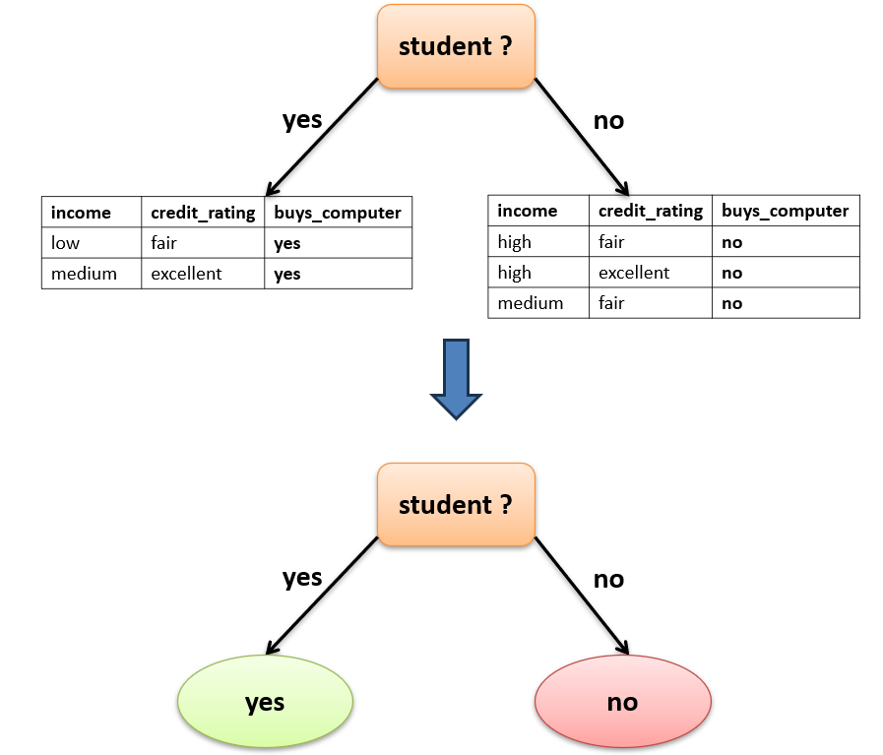
The attribute student has the highest information gain and therefore becomes the splitting attribute at the next level node of the decision tree.
Branches are grown for each outcome of student. The tuples are shown partitioned accordingly.

Slide 34
Let’s continue the same process for the age is “senior”.
If you continue the above process then we will get the attribute credit_rating has the highest information gain and therefore becomes the splitting attribute at the next level node of the decision tree.
Branches are grown for each outcome of credit_rating. The tuples are shown partitioned accordingly.

Slide 35
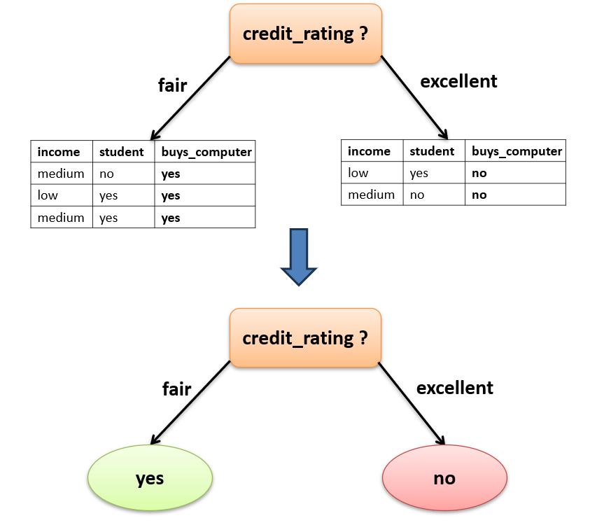

Slide 36
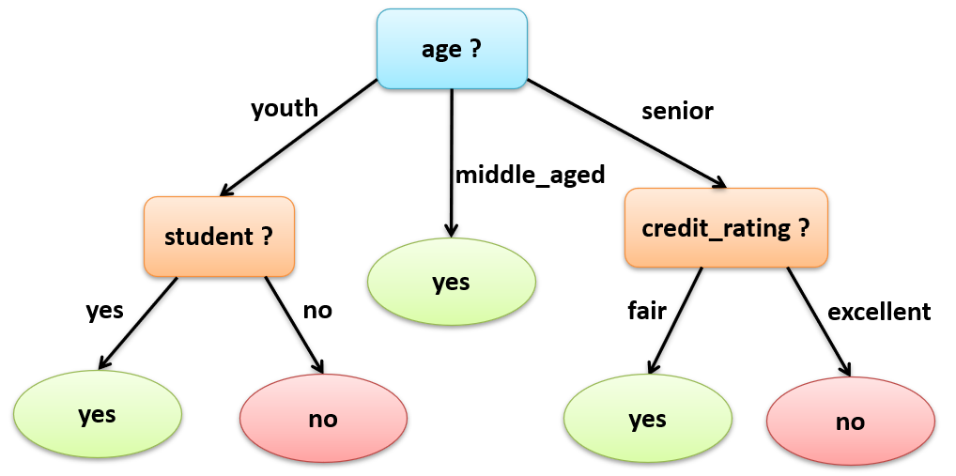
The final decision tree for all the attributes in the above dataset using ID3 algorithm.
Fig: Decision tree

Slide 37
Let us illustrate the ID3 algorithm with a simple example of classifying golf play based on weather conditions. (or) Construct a decision tree to classify “golf play.” Consider the following dataset:
Outlook | Temperature | Humidity | Wind | Golf_Play
Sunny | Hot | High | Weak | No
Sunny | Hot | High | Strong | No
Overcast | Hot | High | Weak | Yes
Rain | Mild | High | Weak | Yes
Rain | Cool | Normal | Weak | Yes
Rain | Cool | Normal | Strong | No
Overcast | Cool | Normal | Strong | Yes
Sunny | Mild | High | Weak | No
Sunny | Cool | Normal | Weak | Yes
Rain | Mild | Normal | Weak | Yes
Sunny | Mild | Normal | Strong | Yes
Overcast | Mild | High | Strong | Yes
Overcast | Hot | Normal | Weak | Yes
Rain | Mild | High | Strong | No

