Slide 1
Double linked list

Slide 2

DLL

Slide 3

Inserting node at start

Slide 4

Inserting node at end

Slide 5

Inserting node at middle

Slide 6
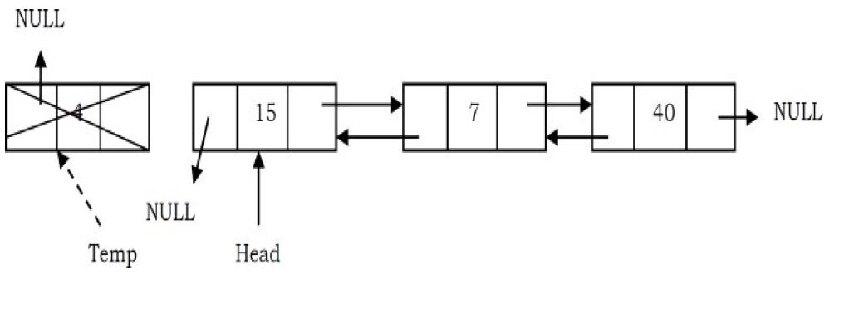
Deleting node at front

Slide 7
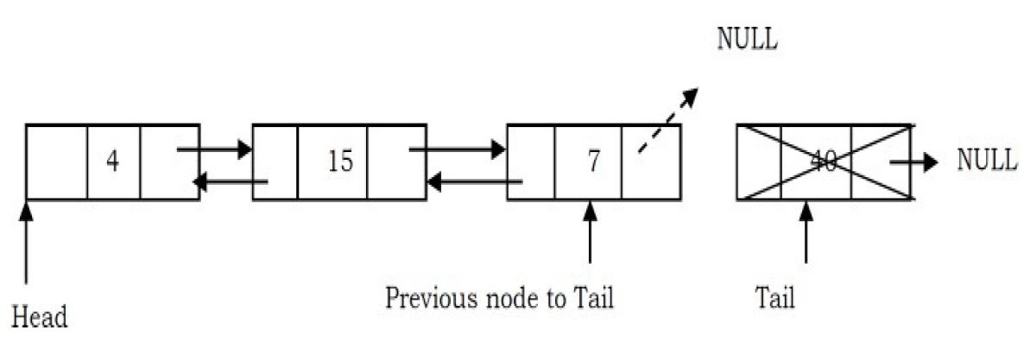
Deleting node at end

Slide 8

Deleting node at middle

Slide 9
