Slide 1
Implicit Objects in JSP
These objects are created by the web container that are available to all the jsp pages.
These objects are also called as Pre-Defined Variables in JSP.
JSP implicit objects are created during the translation phase of JSP to the servlet.
There are 9 types of implicit objects available in the JSP :
1.out 6.application
2.request 7.pageContext
3.response 8.page
4.session 9.config
5.exception

Slide 2
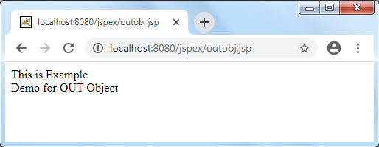
Out Object:
Out is one of the implicit objects to write the data to the buffer and send output to the client(browser) in response.
It is the object of JspWriter Class.
Example: “outobj.jsp”
<html>
<body>
<% out.print("This is Example <br/> ");
out.print(" Demo for OUT Object");
%>
</body>
</html>

Slide 3
Request Object:
The request is an implicit object of type HttpServletRequest. It was created for each jsp request by the web container.
It can be used to get request information from web page or document.
By using this request object ,we can able read values from input elements in JSP.
Example: “requestobj.html”
<html>
<head>
<title>Request Object</title>
</head>
<body>
<form action="requestobj.jsp">
<input type="text" name="uname">
<input type="submit" value="go"><br/>
</form>
</body>
</html>

Slide 4
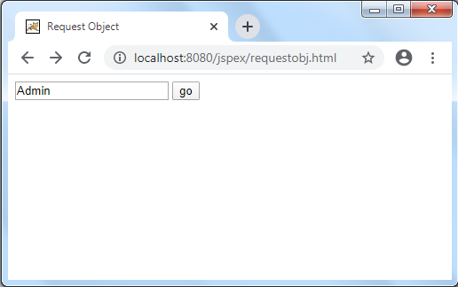
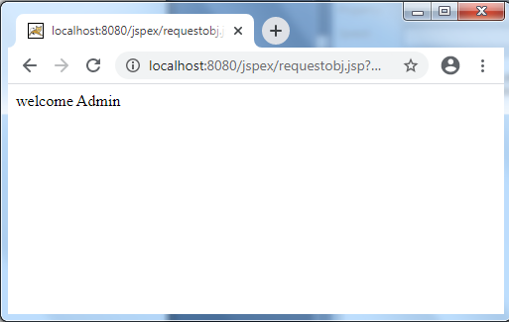
requestobj.jsp
<%
String name=request.getParameter("uname");
out.print("welcome "+name);
%>
Output:

Slide 5
Response Object:
In JSP, response is an implicit object of type HttpServletResponse. It is created by the web container for each jsp request.
It can be used to add or manipulate response such as redirect response to another resource, send error etc.
Example:
<html>
<head>
<title>Response Object</title>
</head>
<body>
<form action="responseobj.jsp">
URL:<input type="text" name="url">
<input type="submit" value="go"><br/>
</form>
</body>
</html>

Slide 6
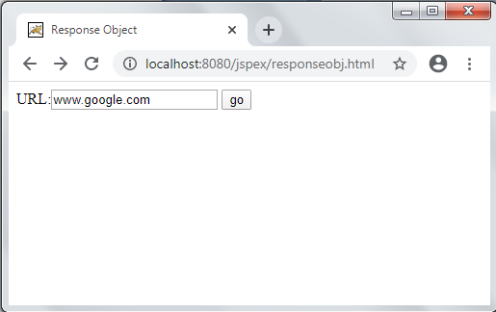
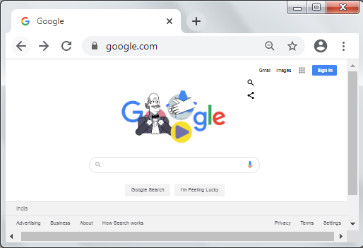
responseobj.jsp
<%
String url=request.getParameter("url");
response.sendRedirect("http://"+url);
%>
Output:

Slide 7
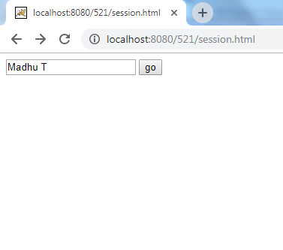
Session Object:
In JSP, session is an implicit object of type HttpSession. We can use this object to set, get or remove attribute or to get session information.
Example:
Session.html
<html>
<body>
<form action="welcome.jsp">
<input type="text" name="uname">
<input type="submit" value="go">
</form>
</body>
</html>

Slide 8
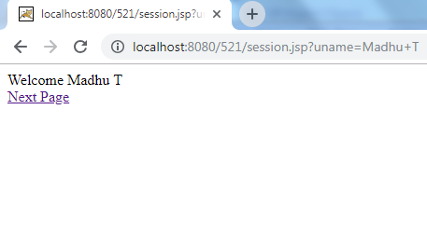
session.jsp
<html>
<body>
<%
String name=request.getParameter("uname");
out.print("Welcome "+name);
session.setAttribute("user",name);
%>
<br/>
<a href="second.jsp">Next Page</a>
</body>
</html>

Slide 9
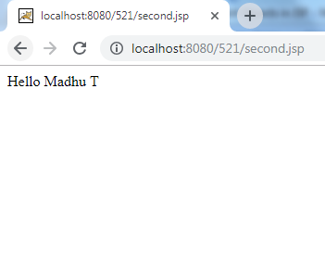
second.jsp
<html>
<body>
<%
String name=(String)session.getAttribute("user");
out.print("Hello "+name);
%>
</body>
</html>

Slide 10
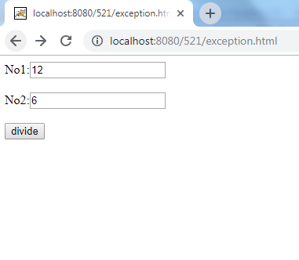
Exception Object:
The exception is normally an object that is thrown at runtime. Exception Handling is the process to handle the runtime errors. There may occur exception any time in your web application.
In JSP, exception is an implicit object of type java.lang.Throwable class. This object can be used to print the exception. But it can only be used in error pages.
Example:
exception.html
<html>
<body>
<form action="process.jsp">
No1:<input type="text" name="n1" />
No2:<input type="text" name="n2" />
<input type="submit" value="divide"/>
</form>
</body>
</html>

Slide 11
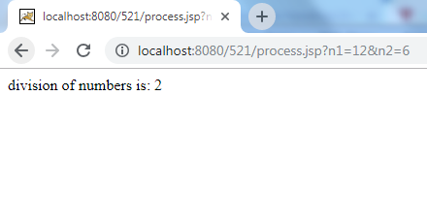
process.jsp
<%@ page errorPage="error.jsp" %>
<%
String num1=request.getParameter("n1");
String num2=request.getParameter("n2");
int a=Integer.parseInt(num1);
int b=Integer.parseInt(num2);
int c=a/b;
out.print("division of numbers is: "+c);
%>

Slide 12
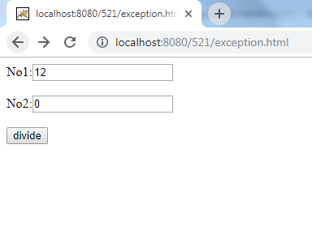
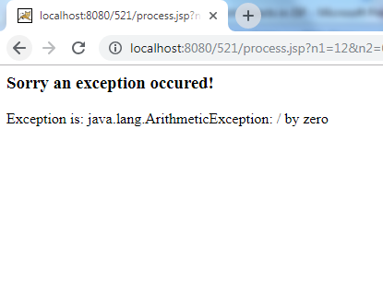
error.jsp
<html>
<body>
<%@ page isErrorPage="true" %>
<h3>Sorry an exception occured!</h3>
Exception is: <%= exception %>
</body>
</html>

Slide 13
Application Object:
This is basically used for getting initialization parameters and for sharing the attributes & their values across the entire JSP application.
which means any attribute set by application implicit object would be available to all the JSP pages.
getAttribute(String attributeName): It returns the object stored in a given attribute name.
Ex:String s = (String)application.getAttribute("MyAttr");
setAttribute(String attributeName, Value): It sets the value of an attribute or in other words it stores an attribute and its value in application context, which is available to use across JSP application.
Ex:application.setAttribute(“MyAttr”, “value”);

Slide 14
applnobj.jsp
<html>
<%
Integer counter= (Integer)application.getAttribute("numOfVisits");
if( counter ==null || counter == 0 ){
counter = 1;
}else{
counter = counter+ 1;
}
application.setAttribute("numOfVisits", counter);
%>
<h3>Total number of hits to this Page is: <%= counter%></h3>
</html>

Slide 15
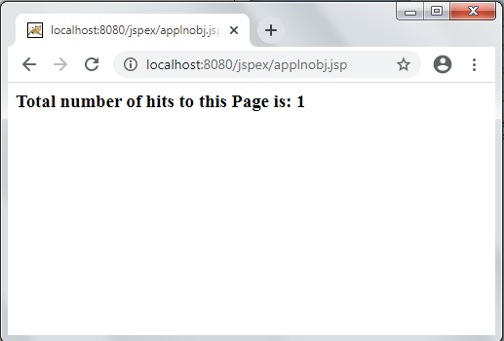
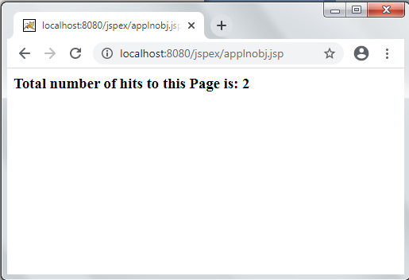
Output:

Slide 16
pageContext Object:
In JSP, pageContext is an implicit object of type PageContext class.
The pageContext object can be used to set, get or remove attribute from one of the following scopes:
page – Scope: PAGE_CONTEXT
request – Scope: REQUEST_CONTEXT
session – Scope: SESSION_CONTEXT
application – Scope: APPLICATION_CONTEXT
In JSP, page scope is the default scope.
Methods of pageContext Implicit Object
getAttribute (String AttributeName, int Scope)
setAttribute(String AttributeName, AttributeValue, int Scope)

Slide 17
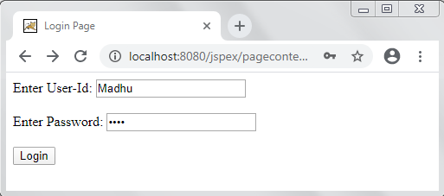
pagecontextobj.html
<html>
<head><title> Login Page</title></head>
<body>
<form action="pagecontextobj.jsp">
Enter User-Id: <input type="text" name="uid"><br><br>
Enter Password: <input type="password" name="upass"><br><br>
<input type="submit" value="Login">
</form>
</body>
</html>

Slide 18
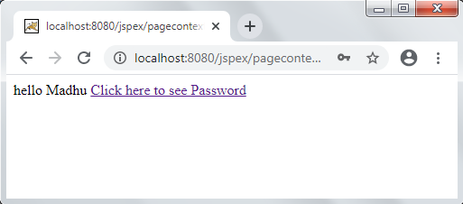
pagecontextobj.jsp
<html>
<body>
<% String id=request.getParameter("uid");
String pass=request.getParameter("upass");
out.println("hello "+id);
pageContext.setAttribute("uname", id, PageContext.SESSION_SCOPE);
pageContext.setAttribute("pwd", pass, PageContext.SESSION_SCOPE);
%>
<a href="display.jsp">Click here to see Password </a>
</body>
</html>

Slide 19
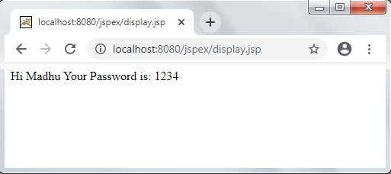
display.jsp
<html>
<body>
<%
String uname= (String) pageContext.getAttribute("uname", PageContext.SESSION_SCOPE);
String pwd= (String) pageContext.getAttribute("pwd", PageContext.SESSION_SCOPE);
out.println("Hi "+uname);
out.println("Your Password is: "+pwd);
%>
</body>
</html>

Slide 20
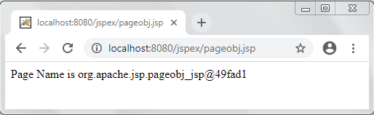
page Object:
Page implicit variable holds the currently executed servlet object for the corresponding jsp.
Acts as this object for current jsp page.
This object is very rarely used.
Example:
<html>
<body>
<% String pageName = page.toString();
out.println("Page Name is " +pageName);%>
</body>
</html>

Slide 21
config Object:
In JSP, config is an implicit object of type ServletConfig. This object can be used to get initialization parameter for a particular JSP page.
The config object is created by the web container for each jsp page.
Generally, it is used to get initialization parameter from the web.xml file.
Example: “configobj.jsp”
<html>
<body>
<%
String sname=config.getServletName();
out.print("Servlet Name is: "+sname);
%>
</body>
</html>

Slide 22
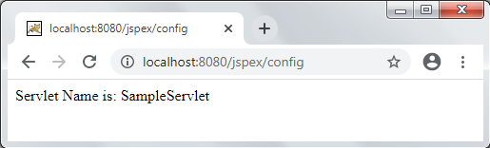
web.xml
<web-app>
<servlet>
<servlet-name>SampleServlet</servlet-name>
<jsp-file>/configobj.jsp</jsp-file>
</servlet>
<servlet-mapping>
<servlet-name>SampleServlet</servlet-name>
<url-pattern>/config</url-pattern>
</servlet-mapping>
</web-app>

