Slide 1
Working with Files in JAVA

Slide 2
A file is a named location that can be used to store related information.
For example:
“Sample.java” is a Java file that contains information about the Java program.
A directory is a collection of files and subdirectories.
A directory inside a directory is known as subdirectory.
In Java, with the help of File Class, we can work with files. This File Class is inside the java.io package.
2

Slide 3
File operations in Java
The following are the several operations that can be performed on a file in Java :
    Create a File
    Read from a File
    Write to a File
    Delete a File
To create perform File operations, we need to create object of File.
Format to create File Object:
File fileobj = new File(String path/FileName);
Example:
File obj = new File("newFile.txt");
2

Slide 4
Create a File
To create a file in Java, you can use the createNewFile() method. This method returns a boolean value: true if the file was successfully created, and false if the file already exists.
Note that the method is enclosed in a try...catch block. This is necessary because it throws an IOException if an error occurs (if the file cannot be created for some reason).
3

Slide 5
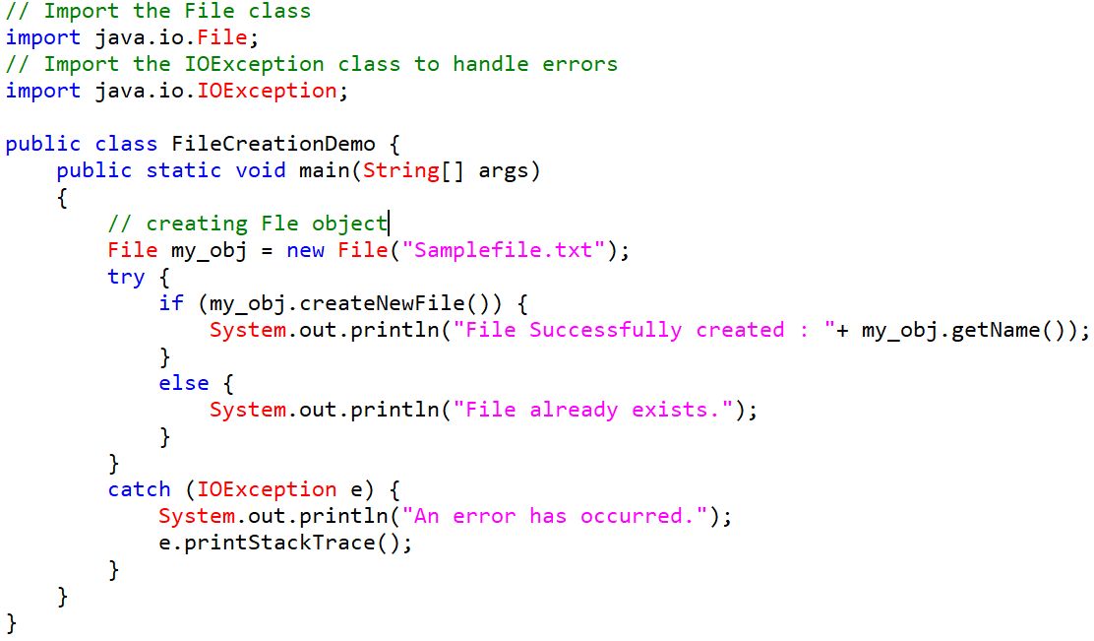
Example Program:

Slide 6
Read from a File
To read data from the file, we can use either Scanner or FileReader class.
To read data from the file using file FileReader class ,You can use read() method. It reads the data character by character.
FileReader obj = new FileReader("Samplefile.txt");
// Reads characters
obj.read(my_array);
We will use the Scanner class also in order to read contents from a file.
File my_obj = new File("Samplefile.txt");
Scanner sc_R = new Scanner(my_obj);
3

Slide 7
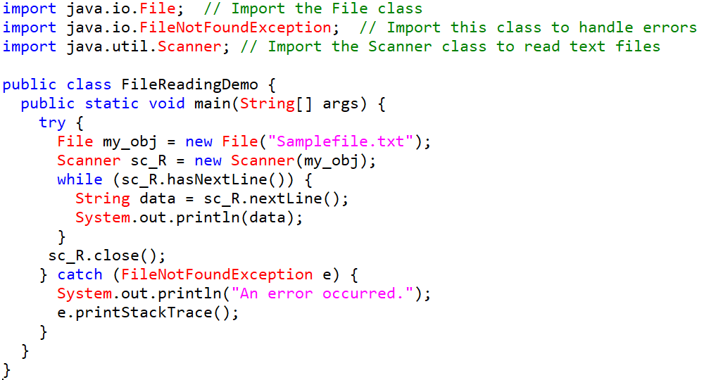
Example Program: Scanner Class

Slide 8
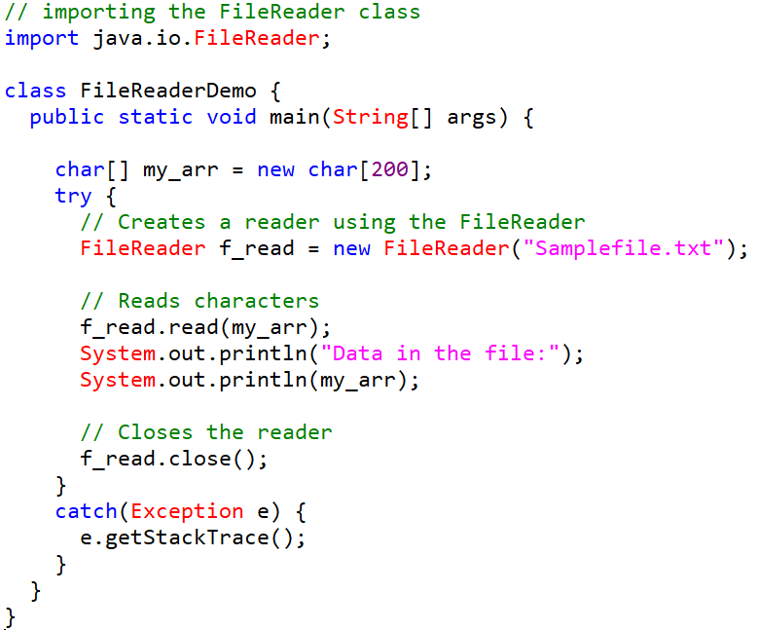
Example Program: FileReader Class

Slide 9
Write to a File
We use the FileWriter class along with its write() method in order to write some text to the file.
// Creates a writer using the FileWriter
FileWriter f_wr = new FileWriter("Samplefile.txt");
// to write the text
f_wr.write("Working with Files in Java!!");
// to close the writer
f_wr.close();
Note : You should close it with the close() method
3

Slide 10
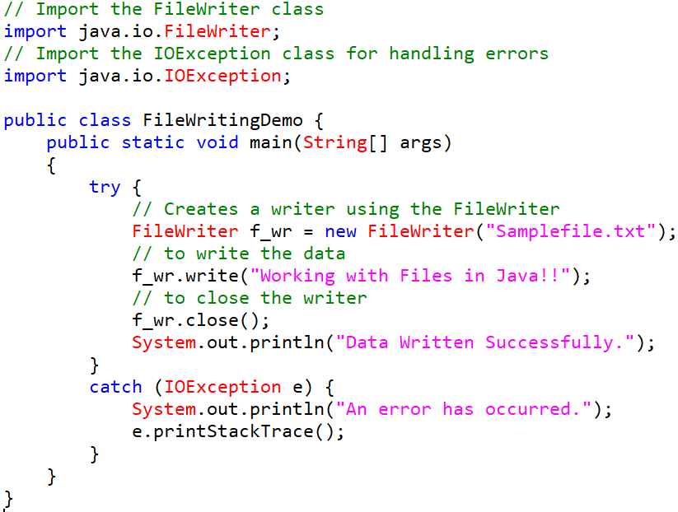
Example Program: FileWriter Class

Slide 11
Delete to a File
We can use the delete() method of the File class to delete the specified file or directory.
It returns
true if the file is deleted.
false if the file does not exist.
Note: We can only delete empty directories.
3

Slide 12
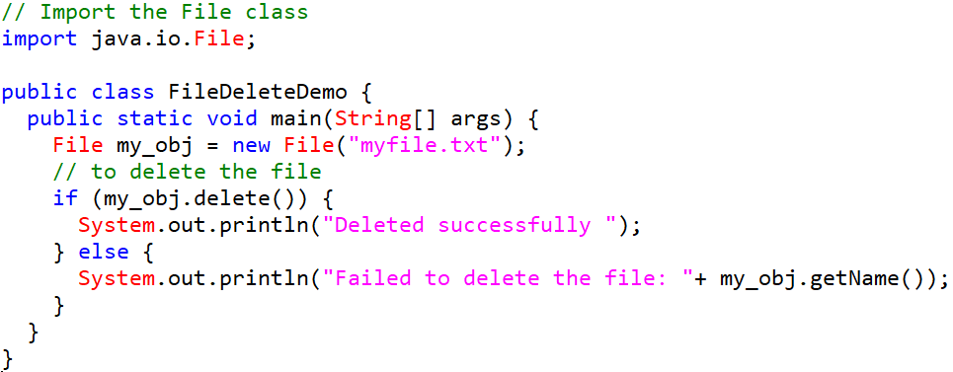
Example Program:

Slide 13
File Operation Methods :
Operation | Method | Package
To create file | createNewFile() | java.io.File
To read file | read() | java.io.FileReader
To write file | write() | java.io.FileWriter
To delete file | delete() | java.io.File

