Slide 1
Partitioning Methods
(k-Means)

Slide 2
The simplest and most fundamental version of cluster analysis is partitioning, which organizes the objects of a set into several exclusive groups or clusters.
Formally, given a data set, D, of n objects, and k, the number of clusters to form, a partitioning algorithm organizes the objects into k partitions (k <= n), where each partition represents a cluster.
The most commonly used partitioning methods are k-means and k-medoids.

Slide 3
k-means Clustering Algorithm

Slide 4
K-Means Clustering is an Unsupervised Learning algorithm, which groups the unlabelled dataset into different clusters. Here K defines the number of pre-defined clusters that need to be created in the process, as if K=2, there will be two clusters, and for K=3, there will be three clusters, and so on.
It is an iterative algorithm that divides the unlabelled dataset into k different clusters in such a way that each data point belongs only one group that has similar properties.
It is a centroid-based algorithm, where each cluster is associated with a centroid.

Slide 5
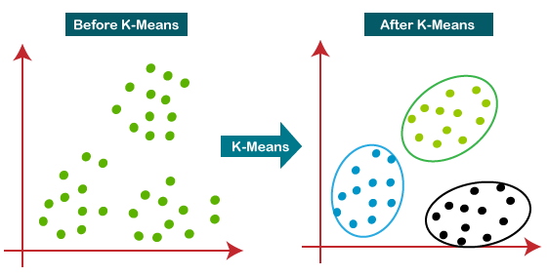
How does the K-Means Algorithm Work?
The algorithm takes the unlabelled dataset as input, divides the dataset into k-number of clusters, and repeats the process until it does not find the best clusters. The value of k should be predetermined in this algorithm.

Slide 6
K-Means Algorithm:
The working of the K-Means algorithm is explained in the below steps:
Step-1: Select the number K to decide the number of clusters.
Step-2: Select random K points or centroids. (It can be other from the input dataset).
Step-3: Assign data point to their closest cluster centre according to the similarity or distance (Euclidean distance).
Step-4: Calculate the centroid or mean of all objects in each cluster.
Step-5: Repeat 3 and 4 steps, which means reassign each datapoint to the new closest centroid of each cluster.
Step-6: If any reassignment occurs, then go to step-4 else go to FINISH.

Slide 7
Start
Select Number K (number of clusters)
Select random K Centroids
Assign each data point to nearest cluster
Yes
Any data point reassigned ?
Calculate the New Centroid of each cluster
Clusters formed
No
End

Slide 8
How to Compute the Distance?
The k-means algorithm enables us to clusters or groups the data points by calculating the distance from centroids to existing data points.
To calculate the distance we use any of the following are Distance Measures.
  Euclidean distance
  Manhattan distance

Slide 9
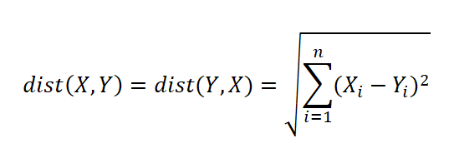
  Euclidean distance:
Euclidean distance can be simply explained as the ordinary distance between two points.
Mathematically it computes the root of squared differences between the coordinates between two objects.
The Euclidean distance between two points or tuples, say, X = (x1, x2, . . . , xn) and Y = (y1, y2, . .. , yn) is

Slide 10
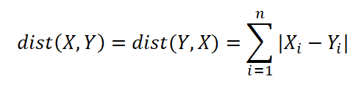
  Manhattan distance:
Manhattan Distance metric is generally used when we are interested in the total distance travelled by the object instead of the displacement.
This distance is calculated by summing the absolute difference between the coordinates of the points in n-dimensions.
The Manhattan distance between two points or tuples, say, X = (x1, x2, . . . , xn) and Y = (y1, y2, . . . , yn) is

Slide 11
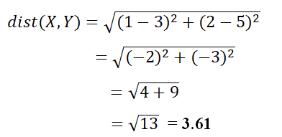

Examples to calculate distances:
Let X = (1, 2) and Y = (3, 5) represent two data points.
The Euclidean distance between the two data points is
The Manhattan distance between the two data points is

Slide 12
Example: k-means algorithm
Suppose we want to group the visitors to a website using just their age as follows:
16, 17, 20, 21, 22, 23, 29, 36, 41, 43, 44, 45, 61, 62
Solution:
Step 1:
First, Initialize the number of clusters i.e. K value.
Let Us K = 2

Slide 13
Step 2:
Next, Select random K=2 points or centroids.
i.e.
centroid (c1) = 17
centroid (c2) = 23
Step 3:
Now, calculate the distance from each data point to each centroid.
Let us assume Distance 1 is the distances from each data point (X_{i}) to centroid 1(C₁)
Distance 1 = | X_{i} - C₁|

Slide 14
Distance 2 is the distances from each data point (X_{i} ) to centroid 2(C₂)
Distance 2 = | X_{i} - C₂|
Iteration 1:
The Initial centroids are
centroid (c1) = 17
centroid (c2) = 23

Slide 15
x_{i} | c₁ | c₂ | Distance 1 | Distance 2 | Nearest Cluster | New Centroid
16 | 17 | 23 | 1 | 7 | 1 | 16.5
17 | 17 | 23 | 0 | 6 | 1
20 | 17 | 23 | 3 | 3 | 2 | 37.25
21 | 17 | 23 | 4 | 2 | 2
22 | 17 | 23 | 5 | 1 | 2
23 | 17 | 23 | 6 | 0 | 2
29 | 17 | 23 | 12 | 6 | 2
36 | 17 | 23 | 19 | 13 | 2
41 | 17 | 23 | 24 | 18 | 2
43 | 17 | 23 | 26 | 20 | 2
44 | 17 | 23 | 27 | 21 | 2
45 | 17 | 23 | 28 | 22 | 2
61 | 17 | 23 | 44 | 38 | 2
62 | 17 | 23 | 45 | 39 | 2

Slide 16
Step:4
The Updated centroids are
centroid (c1)
=mean (16,17)
= 16.5
centroid (c2)
= mean (20, 21, 22, 23, 29, 36, 41, 43, 44, 45, 61, 62)
= 37.25

Slide 17
Iteration-2
x_{i} | c₁ | c₂ | Distance 1 | Distance 2 | Nearest Cluster | New Centroid
16 | 16.5 | 37.25 | 0.5 | 21.25 | 1 | 19.83
17 | 16.5 | 37.25 | 0.5 | 20.25 | 1
20 | 16.5 | 37.25 | 3.5 | 17.25 | 1
21 | 16.5 | 37.25 | 4.5 | 16.25 | 1
22 | 16.5 | 37.25 | 5.5 | 15.25 | 1
23 | 16.5 | 37.25 | 6.5 | 14.25 | 1
29 | 16.5 | 37.25 | 12.5 | 8.25 | 2 | 45.12
36 | 16.5 | 37.25 | 19.5 | 1.25 | 2
41 | 16.5 | 37.25 | 24.5 | 3.75 | 2
43 | 16.5 | 37.25 | 26.5 | 5.75 | 2
44 | 16.5 | 37.25 | 27.5 | 6.75 | 2
45 | 16.5 | 37.25 | 28.5 | 7.75 | 2
61 | 16.5 | 37.25 | 44.5 | 23.75 | 2
62 | 16.5 | 37.25 | 45.5 | 24.75 | 2

Slide 18
Step:4
The Updated centroids are
centroid (c1)
=mean (16, 17, 20, 21, 22, 23)
= 19.83
centroid (c2)
= mean (29, 36, 41, 43, 44, 45, 61, 62)
= 45.12

Slide 19
Iteration-3
x_{i} | c₁ | c₂ | Distance 1 | Distance 2 | Nearest Cluster | New Centroid
16 | 19.83 | 45.12 | 3.83 | 29.12 | 1 | 21.14
17 | 19.83 | 45.12 | 2.83 | 28.12 | 1
20 | 19.83 | 45.12 | 0.17 | 25.12 | 1
21 | 19.83 | 45.12 | 1.17 | 24.12 | 1
22 | 19.83 | 45.12 | 2.17 | 23.12 | 1
23 | 19.83 | 45.12 | 3.17 | 22.12 | 1
29 | 19.83 | 45.12 | 9.17 | 16.12 | 1
36 | 19.83 | 45.12 | 16.17 | 9.12 | 2 | 47.42
41 | 19.83 | 45.12 | 21.17 | 4.12 | 2
43 | 19.83 | 45.12 | 23.17 | 2.12 | 2
44 | 19.83 | 45.12 | 24.17 | 1.12 | 2
45 | 19.83 | 45.12 | 25.17 | 0.12 | 2
61 | 19.83 | 45.12 | 41.17 | 15.88 | 2
62 | 19.83 | 45.12 | 42.17 | 16.88 | 2

Slide 20
Step:4
The Updated centroids are
centroid (c1)
=mean (16, 17, 20, 21, 22, 23,29)
= 21.14
centroid (c2)
= mean (36, 41, 43, 44, 45, 61, 62)
= 47.42

Slide 21
Iteration-4
x_{i} | c₁ | c₂ | Distance 1 | Distance 2 | Nearest Cluster | New Centroid
16 | 21.14 | 47.42 | 5.14 | 31.42 | 1 | 21.14
17 | 21.14 | 47.42 | 4.14 | 30.42 | 1
20 | 21.14 | 47.42 | 1.14 | 27.42 | 1
21 | 21.14 | 47.42 | 0.14 | 26.42 | 1
22 | 21.14 | 47.42 | 0.86 | 25.42 | 1
23 | 21.14 | 47.42 | 1.86 | 24.42 | 1
29 | 21.14 | 47.42 | 7.86 | 18.42 | 1
36 | 21.14 | 47.42 | 14.86 | 11.42 | 2 | 47.42
41 | 21.14 | 47.42 | 19.86 | 6.42 | 2
43 | 21.14 | 47.42 | 21.86 | 4.42 | 2
44 | 21.14 | 47.42 | 22.86 | 3.42 | 2
45 | 21.14 | 47.42 | 23.86 | 2.42 | 2
61 | 21.14 | 47.42 | 39.86 | 13.58 | 2
62 | 21.14 | 47.42 | 40.86 | 14.58 | 2

Slide 22
No change between iterations 3 and 4 has been noted. By using clustering, 2 groups have been identified 16-29 and 36-62.
The resultant clusters are
Cluster 1: 16, 17, 20, 21, 22, 23, 29
Cluster 2: 36, 41, 43, 44, 45, 61, 62

