Slide 1
Multimedia Data Mining
- extracting interesting information from multimedia databases.

Slide 2
What is Multimedia Mining?
Multimedia data mining discovers interesting patterns from multimedia databases that store and manage large collections of multimedia objects.
The Multimedia data includes the following:
  image data,
  video data,
  audio data,
  sequence data,
  hypertext data containing text.

Slide 3
Multimedia data mining has a number of uses in today’s society. An example of this would be the use of traffic camera footage to analyze traffic flow.
Multimedia data mining can be defined as a process that finds patterns in various types of data, including images, audio, video, and animation.

Slide 4
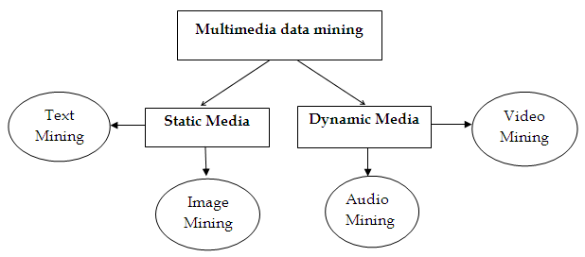
Categories of Multimedia Data Mining
Multimedia data mining is classified into two broad categories: static and dynamic media.

Slide 5
Text mining
Text Mining also referred to as text data mining and it is used to find meaningful information from the unstructured texts that are from various sources.
Image mining
Image mining systems can discover meaningful information or image patterns from a huge collection of images.

Slide 6
Video mining
Video mining has the objective of describing interesting patterns form large amount of video data.
Video has several type of multimedia data such as image, text, audio, visual etc.
It is widely used in application such as entertainment, medicine, education, sports etc.
Audio mining
Audio mining is the technique in which audio signals are automatically analyzed and searched. This technique is generally implemented in automatic speech recognition.

Slide 7
Applications of Multimedia Mining:
Digital Library
Traffic Video Sequences
Medical Analysis
Media Making and Broadcasting
Surveillance system

Slide 8
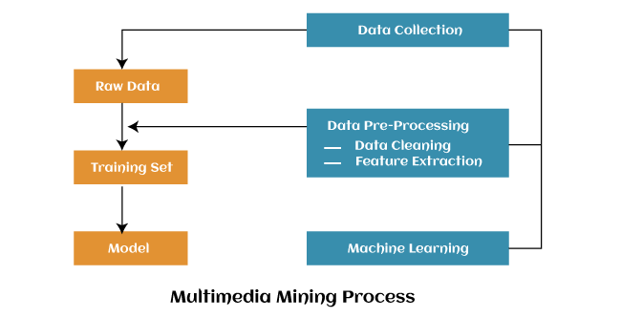
Process of Multimedia Data Mining:

Slide 9
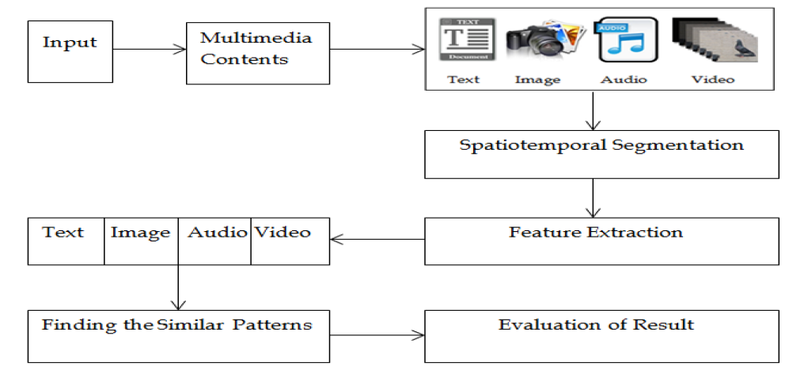
Architecture for Multimedia Data Mining:

Slide 10
We considered two main families of multimedia retrieval systems, i.e. similarity search in multimedia data.
Description-based retrieval system creates indices and object retrieval based on image descriptions, such as keywords, captions, size, and creation time.
Content-based retrieval system supports image content retrieval, for example, color histogram, texture, shape, objects, and wavelet transform.

Slide 11
Models for Multimedia Mining
The data mining models / techniques that are applied to multimedia data are
classification,
clustering,
association rule mining

