Slide 1
Queue Linked List
Terminology: Front, Rear, Node, Data, Next, NULL
Operations: Enqueue( ), Dequeue( ), Display()

Slide 2
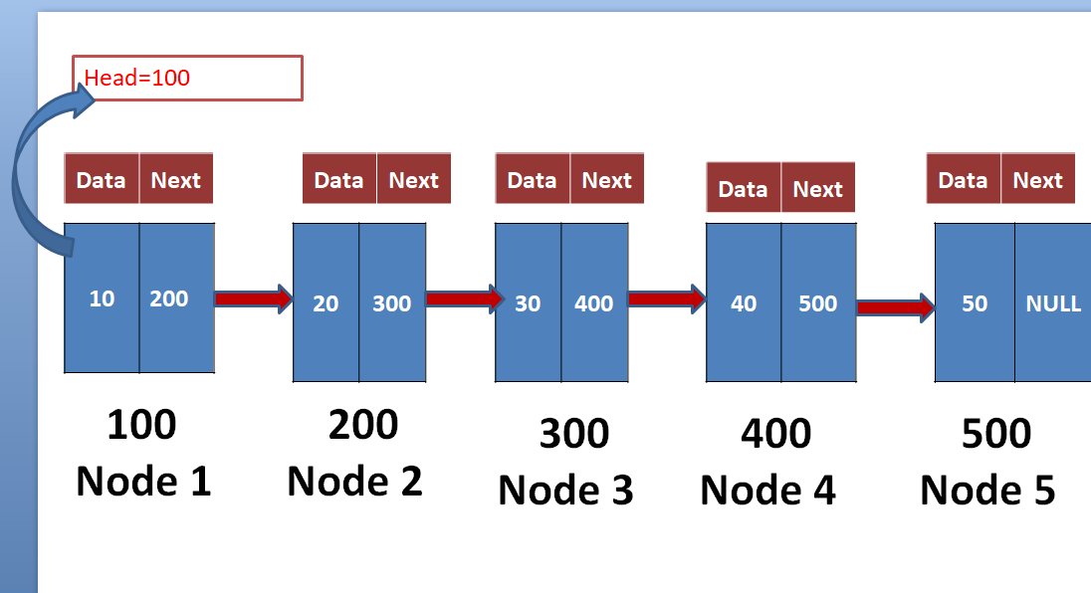
Queue using SLL
Front
Rear

Slide 3
Content
What is Queue Single linked list
Queue working principle
What is node?
Node Structure.
Operations on Queue SLL.

Slide 4
What is Queue Single linked list
List: collection of number of elements
SLL: SLL is linear Data Structure.
It is also a collection of elements(nodes) but every element is linked with next element(node) by address.
Queue SLL: Implement the queue data structure with single linked list concept.
The Problem with queue using array is fixed size. But Queue using SLL is unlimited size.

Slide 5
What is Queue Single linked list
Queue SLL uses two pointer fields
1) Front: it is used for delete the elements from the list
2) Rear: it is used to insert the elements into the list

Slide 6
Queue using SLL
Front
Rear

Slide 7


Queue working Principle
In queue data structure, the insertion and deletion operations are performed based on
FIFO (First In First Out) principle.

Slide 8
What is node?
Every single element in a List is called “Node”.
Node contains two fields
1) Data filed-it holds data(element value)
2) Next field- it holds address of next node
Every node has it’s own address value in the memory

Slide 9
Data | Next
Node
100

Slide 10
Node Structure
Structure Node
{
Int data;
Structure Node *Next;
}*front=NULL,*rear=NULL;
Data | Next
Node
100

Slide 11
Operations on SLL.
Enqueue(): it is used to insert the node at Rear.
Dequeue(): it is used to delete the node at Front.
Display(): it is used to display the nodes from the list.

Slide 12
Algorithm for Enqueue()
enqueue(value) :It is used inserting an element into the Queue
Step 1 :Create a NewNode with given value and set ‘NewNode → next' to NULL.
Step 2 :Check whether queue is Empty (rear == NULL && front==NULL)
Step 3 : If it is Empty then, set front = NewNode and rear = NewNode.
Step 4 : If it is Not Empty then,
set rear → next = NewNode and rear = NewNode.

Slide 13
Connecting nodes by address
1)Before creating first node :: Assign front=rear=NULL
Data | Next
10
NULL
Node1=(*struct Node)malloc(sizeof(*struct Node);
Node1->data=10;
Node1->next=NULL;
100
Node 1
If(front==NULL && rear==NULL)
{
front=rear=node1;
}
i.e:
100->data=10;
100->next=NULL;
( first node of list is called “Front” and last node is called ”rear ” in QSLL.

Slide 14
After creating first node Head=first node address
i.e front=rear=100
Front=rear=100
Data | Next
10 | NULL
100
Node 1

Slide 15
Front=rear=100
Data | Next
Data | Next
Node2=(*struct Node)malloc(sizeof(*struct Node);
10
NULL
20
NULL
Node2->data=20;
Node2->next=NULL;
100
Node 1
200
Node 2
If(front==NULL && rear==NULL)
{
front=rear=node2;
}

Slide 16
rear=100
front=100
Rear=200
Data | Next
Data | Next
10
20 | NULL
NULL
200
rear->next=node2;
Rear=newNode;
100
Node 1
200
Node 2

Slide 17
Node3=(*struct Node)malloc(sizeof(*struct Node);
front=100
rear=200
Data | Next
Data | Next
Node3->data=30;
Node3->next=NULL;
Data | Next
10 | 200
20 | NULL
30
NULL
If(front==NULL && rear==NULL)
{
front=rear=node3;
}
100
Node 1
200
Node 2
300
Node 3

Slide 18
front=100
rear=200
rear=300
Data | Next
Data | Next
Data | Next
10 | 200
20
30 | NULL
NULL
300
rear->next=node3;
Rear=newNode;
100
Node 1
200
Node 2
300
Node 3

Slide 19
front=100
rear=300
Data | Next
Data | Next
Data | Next
Data | Next
10 | 200
20 | 300
30 | NULL
40 | NULL
100
Node 1
200
Node 2
300
Node 3
400
Node 4

Slide 20
front=100
rear=400
Data | Next
Data | Next
Data | Next
Data | Next
10 | 200
20 | 300
30 | 400
40 | NULL
100
Node 1
200
Node 2
300
Node 3
400
Node 4

Slide 21
front=100
rear=400
Data | Next
Data | Next
Data | Next
Data | Next
Data | Next
10 | 200
20 | 300
30 | 400
40 | NULL
50 | NULL
100
Node 1
200
Node 2
300
Node 3
400
Node 4
500
Node 5

Slide 22
front=100
rear=500
Data | Next
Data | Next
Data | Next
Data | Next
Data | Next
10 | 200
20 | 300
30 | 400
40 | 500
50 | NULL
100
Node 1
200
Node 2
300
Node 3
400
Node 4
500
Node 5

Slide 23
Algorithm for Dequeue()
dequeue(): Deleting an Element from Queue
Step 1: Check whether queue is Empty
(front == NULL && rear==NULL).
Step 2 : If it is Empty, then display "Queue is Empty, Deletion is not possible" and end from the function
Step 3 : If it is Not Empty then, define a Node pointer 'temp' and set it to 'front'.
Step 4 : Then set 'front = front → next' and delete 'temp' (free(temp)).

Slide 24
front=100
rear=500
Data | Next
Data | Next
Data | Next
Data | Next
Data | Next
10 | 200
20 | 300
30 | 400
40 | 500
50 | NULL
100
Node 1
200
Node 2
300
Node 3
400
Node 4
500
Node 5

Slide 25
temp=100
front=100
Front=200
rear=500
Data | Next
Data | Next
Data | Next
Data | Next
Data | Next
10 | 200
20 | 300
30 | 400
40 | 500
50 | NULL
100
Node 1
200
Node 2
300
Node 3
400
Node 4
500
Node 5
Free (temp)

Slide 26
Front=200
rear=500
Data | Next
Data | Next
Data | Next
Data | Next
20 | 300
30 | 400
40 | 500
50 | NULL
200
Node 2
300
Node 3
400
Node 4
500
Node 5

Slide 27
temp=200
Front=200
Front=300
rear=500
Data | Next
Data | Next
Data | Next
Data | Next
20 | 300
30 | 400
40 | 500
50 | NULL
200
Node 2
300
Node 3
400
Node 4
500
Node 5
Free (temp)

Slide 28
temp=300
Front=300
Front=400
rear=500
Data | Next
Data | Next
Data | Next
30 | 400
40 | 500
50 | NULL
300
Node 3
400
Node 4
500
Node 5
Free (temp)

Slide 29
temp=400
Front=500
Front=400
rear=500
Data | Next
Data | Next
40 | 500
50 | NULL
400
Node 4
500
Node 5
Free (temp)

Slide 30
temp=500
Front=500
Front=NULL
rear=500
rear=NULL
Data | Next
front == NULL && rear==NULL).
Queue is Empty, Deletion is not possible
50 | NULL
500
Node 5
Free (temp)

Slide 31
Algorithm for Display()
display(): Display an Element from Queue
Step 1: Check whether queue is Empty
(front == NULL && rear==NULL).
Step 2 : If it is Empty, then display "Queue is Empty, Display is not possible" and end from the function
Step 3 : If it is Not Empty then, define a Node pointer 'temp' and initialize with front.
Step 4 : Display 'temp → data' and move it to the next node. Repeat the same until 'temp' reaches to 'rear' (temp → next != NULL).
Step 5 : Finally! Display 'temp → data ---> NULL'.

Slide 32
front=100
rear=500
Data | Next
Data | Next
Data | Next
Data | Next
Data | Next
10 | 200
20 | 300
30 | 400
40 | 500
50 | NULL
100
Node 1
200
Node 2
300
Node 3
400
Node 4
500
Node 5

Slide 33
Thank You

