Slide 1
Servlets

Slide 2
Web Application:
A web application is an application accessible from the web.
A web application is composed of web components like Servlet, JSP, etc. and other elements such as HTML, CSS, and JavaScript.
The web components typically execute in Web Server and respond to the HTTP request.
Common Gateway Interface:
CGI (Common Gateway Interface) scripting language is a basic server-side programming language. which is used to develop dynamic web pages.
CGI technology enables the web server to call an external program and pass HTTP request information to process the request.

Slide 3
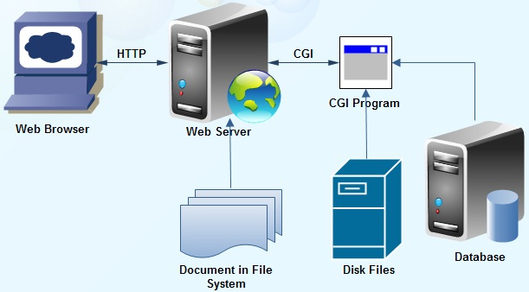
Common Gateway Interface (CGI)

Slide 4
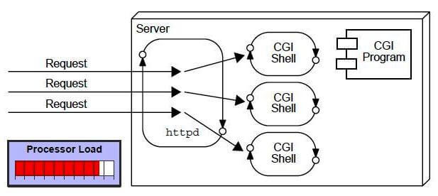
In CGI,For each request, it starts a new process.
Each new process requires separate memory,CPU time so processor load will increase.
There are many problems in CGI technology:
If the number of clients increases, it takes more time for sending the response.
For each request, it starts a process, and the web server is limited to start processes.
It uses platform dependent language e.g. C, C++, perl.

Slide 5
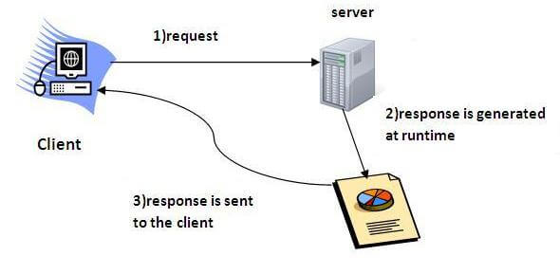
Servlets:
Servlet technology is used to create a web application (resides at server side and generates a dynamic web page).
Servlet technology is robust and scalable because of java language.
Before Servlet, CGI (Common Gateway Interface) scripting language was common as a server-side programming language. However, there were many disadvantages to this technology.
Servlet is a class that extends the capabilities of the servers and responds to the incoming requests.

Slide 6
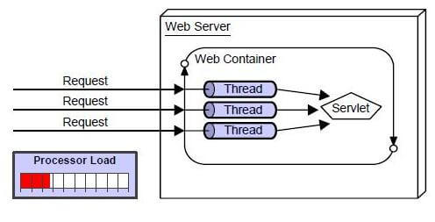
The web container creates threads for handling the multiple requests to the Servlet.
Threads have many benefits over the Processes such as they share a common memory area, lightweight, cost of communication between the threads are low.
The advantages of Servlet are as follows:
Better performance: because it creates a thread for each request, not process.
Portability: because it uses Java language.
Robust: JVM manages Servlets, so we don't need to worry about the memory leak, garbage collection, etc.
Secure: because it uses java language.

Slide 7
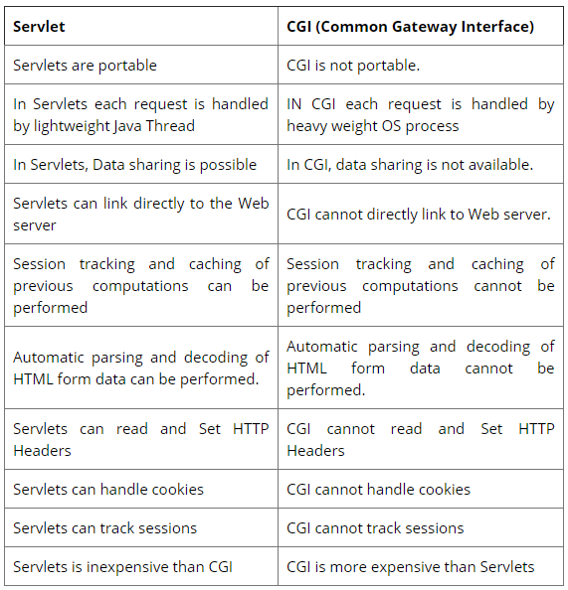
Servlet Vs CGI

Slide 8
Lifecycle of Servlet:
Lifecycle of a servlet describes how and when a servlet is loaded, initialized, able to handle requests and unloaded.
New Instance is Created
There are 3 methods in lifecycle of servlet, those are
  init() : This method initializes the servlet.
  service() : This method process the http requests.
  destroy(): This method is used to destroy the servlet.
Servlet Uninitialized
Init() method Called
One or more Requests processed by service() method
Servlet initialized and Ready to process requests
Destroy() method called
Instance Garbage collected

Slide 9
Create a servlet example
The servlet example can be created by three ways:
  By implementing Servlet interface,
  By inheriting GenericServlet class, (or)
  By inheriting HttpServlet class
Here, we are going to use tomcat server in this example.
The steps are as follows:
  Create a directory structure
  Create a Servlet
  Compile the Servlet
  Create a deployment descriptor
  Start the server
  Access the servlet

Slide 10
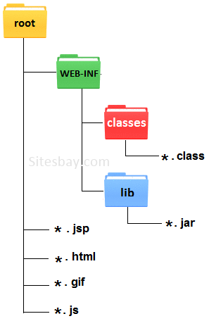
Create a directory structure:
The directory structure defines that where to put the different types of files so that web container may get the information and respond to the client.
Let's see the directory structure that must be followed to create the servlet.

Slide 11
2.Create a servlet:
import java.io.*; First.java
import javax.servlet.*;
public class First extends GenericServlet
{
public void service(ServletRequest req,ServletResponse res)
throws IOException,ServletException{
res.setContentType("text/html");
PrintWriter out=res.getWriter();
out.print("<html><body>");
out.print("<b>Welcome to servlet</b>");
out.print("</body></html>");
}
}

Slide 12
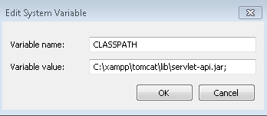
3.Compile the servlet:
Servlet can be compliled by using jar file
Jar file are required to be loaded.
Servlet-api.jar
Two ways to load the jar file
set classpath
paste the jar file in JRE/lib/ext folder
Put the java file in any folder. After compiling the java file, paste the class file of servlet in WEB-INF/classes directory.

Slide 13
4.Create a deployment description:
Deployment description is an XML file with a name web.xml
From this xml file web container gets the information about the servlet to be invoked
Web.xml
<web-app>
  <servlet>
    <servlet-name>hello</servlet-name>
    <servlet-class>First</servlet-class>
  </servlet>
  <servlet-mapping>
    <servlet-name>hello</servlet-name>
    <url-pattern>/welcome</url-pattern>
  </servlet-mapping>
</web-app>

Slide 14
5.Start the server and deploy the project:
There are two ways to deploy the project
  Deployment
    Copy project into c://xampp/tomcat/web-apps
  Start Tomcat server
    By using Xampp control panel
    By running catalina_start batch file.
    (c://xampp/tomcat/)

Slide 15
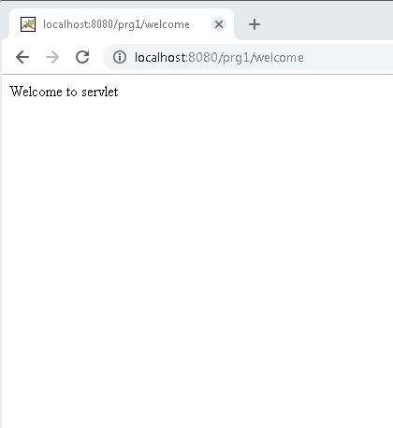
  6. Access the servlet:

Slide 16
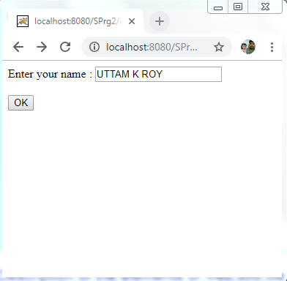
Reading Servlet Parameters:
The Servlet Request class includes methods that allow you to read the names and values of parameters that are included in a client request.
Example: “index.html”
<html>
<body>
<form action="home" method="get">
Enter your name :
<input type="text" name="name"><br>
<input type="submit" value="OK">
</body>
</html>

Slide 17
import javax.servlet.http.*; “ReadingPar.java”
import javax.servlet.*;
import java.io.*;
public class ReadingPar extends HttpServlet{
public void doGet(HttpServletRequest req,HttpServletResponse res)throws ServletException,IOException
{
res.setContentType("text/html");
PrintWriter pw=res.getWriter();
String name=req.getParameter("name");
pw.println("Welcome "+name);
}}
Compilation:
Javac ReadingPar.java

Slide 18
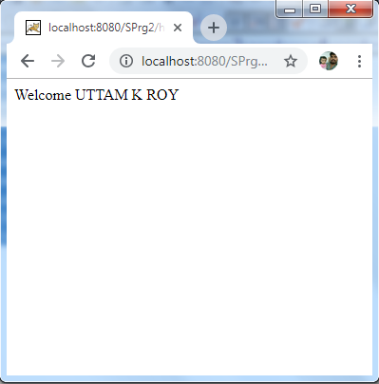
After compiling the java file, paste the class file of servlet in
WEB-INF/classes directory.
“web.xml”
<web-app>
<servlet>
<servlet-name>SPrg2</servlet-name>
<servlet-class>ReadingPar</servlet-class>
</servlet>
<servlet-mapping>
<servlet-name>SPrg2</servlet-name>
<url-pattern>/home</url-pattern>
</servlet-mapping>
</web-app>

Slide 19
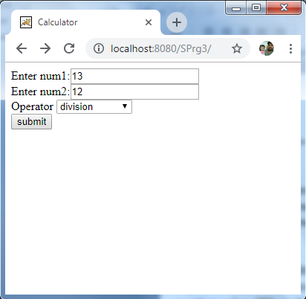
Example: “index.html”
<html>
<head>
<title>Calculator</title>
</head>
<body>
<form action="/SPrg3/evaluate" method="post" name="frm">
Enter num1:<input name="txt1" type="text" /><br>
Enter num2:<input name="txt2" type="text" /><br>
Operator
<select name="op">
<option value="+">Addition</option>
<option value="-">Subtraction</option>
<option value="*">multiplication</option>
<option value="/">division</option>
<option value="%">remainder</option>
</select><br>
<input type="submit" value="submit" />
</form>
</body>
</html>

Slide 20
“Calculator.java”
import java.io.IOException;
import java.io.PrintWriter;
import javax.servlet.ServletException;
import javax.servlet.http.HttpServlet;
import javax.servlet.http.HttpServletRequest;
import javax.servlet.http.HttpServletResponse;
public class Calculator extends HttpServlet {
protected void doPost(HttpServletRequest request, HttpServletResponse response)
throws ServletException, IOException {
PrintWriter out = response.getWriter();
String n1 = request.getParameter("txt1");
String n2 = request.getParameter("txt2");
String op = request.getParameter("op");

Slide 21
if(op.equals("+")){
out.println("SUM IS :" +(Integer.parseInt(n1) + Integer.parseInt(n2)));
}
else if(op.equals("-")){
out.println("SUB IS :" +(Integer.parseInt(n1) - Integer.parseInt(n2)));
}
else if(op.equals("*")){
out.println("MUL IS :" +(Integer.parseInt(n1) * Integer.parseInt(n2)));
}
else if(op.equals("%")){
out.println("MOD IS :" +(Integer.parseInt(n1) % Integer.parseInt(n2)));
}
else{
out.println("DIV IS :" +(Integer.parseInt(n1) / Integer.parseInt(n2)));
}
} }

Slide 22
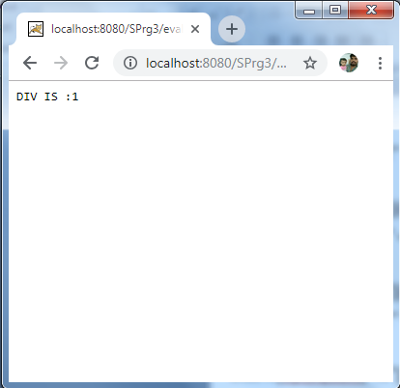
“web.xml”
<web-app>
<servlet>
<servlet-name>SPrg3</servlet-name>
<servlet-class>Calculator</servlet-class>
</servlet>
<servlet-mapping>
<servlet-name>SPrg3</servlet-name>
<url-pattern>/evaluate</url-pattern>
</servlet-mapping>
</web-app>

