Slide 1
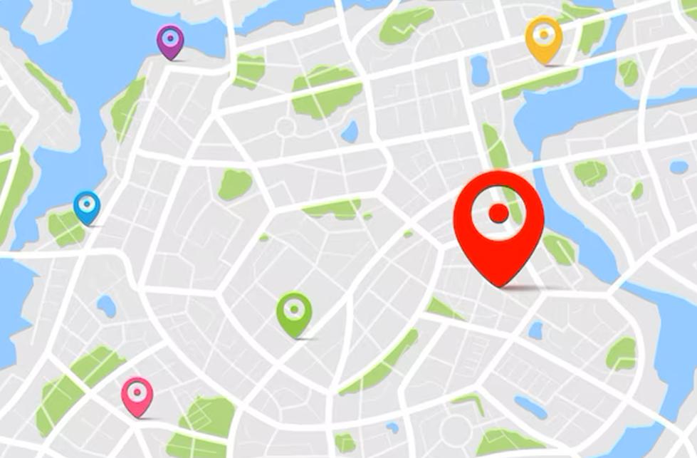
Spatial Data Mining
- a specialized subfield of data mining that deals with extracting knowledge from spatial data.

Slide 2
What is Spatial Data Mining?
Spatial data mining is a specialized subfield of data mining that deals with extracting knowledge from spatial data.
Spatial data refers to data that is associated with a particular location or geography.
Examples of spatial data include maps, satellite images, GPS data, and other geospatial information.

Slide 3
Spatial data mining involves analyzing and discovering patterns, relationships, and trends in this data to gain insights and make informed decisions.
The use of spatial data mining has become increasingly important in various fields, such as logistics, environmental science, urban planning, transportation, and public health.

Slide 4
For instance, a transportation company can optimize its delivery routes for faster and more efficient deliveries using spatial data mining techniques.
They can analyze their delivery data along with other spatial data, such as traffic flow, road network, and weather patterns, to identify the most efficient routes for each delivery.

Slide 5
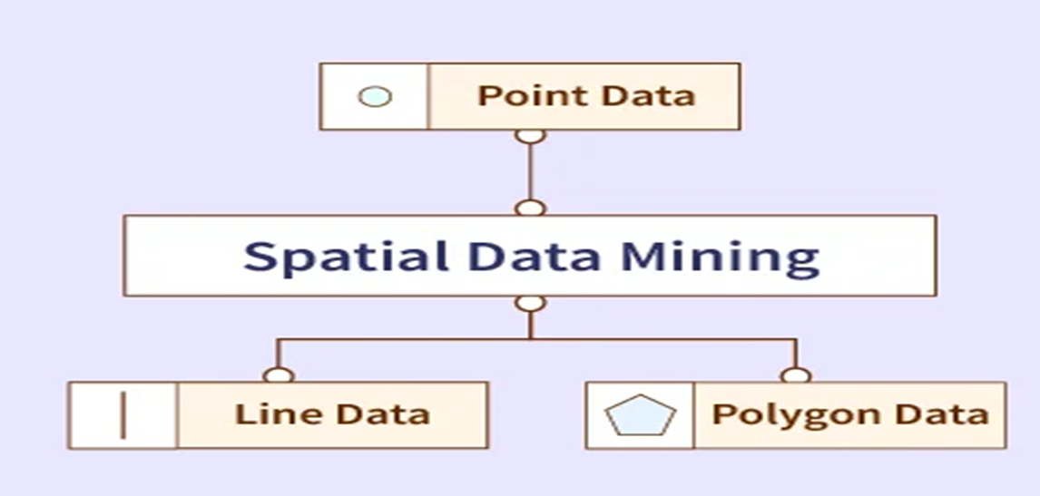
Types of Spatial Data
Different types of spatial data are used in spatial data mining. These include point data, line data, and polygon data.

Slide 6
Point Data
Point data represents a single location or a set of locations on a map. Each point is defined by its x and y coordinates, representing its position in the geographic space.
Point data is commonly used to represent geographic features such as cities, landmarks, or specific locations of interest. Examples of point data in transportation include delivery locations, bus stops, or railway stations.

Slide 7
Line Data
Line data represents a linear feature, such as a road, a river, or a pipeline, on a map. Each line is defined by a set of vertices, which represent the start and end points of the line.
Line data is commonly used to represent `transportation networks, such as roads, highways, or railways.

Slide 8
Polygon Data
Polygon data represents a closed shape or an area on a map. Each polygon is defined by a set of vertices that connect to form a closed boundary.
Polygon data is commonly used to represent administrative boundaries, land use, or demographic data.
In transportation, polygon data can be used to represent areas of interest, such as delivery zones or traffic zones.

Slide 9
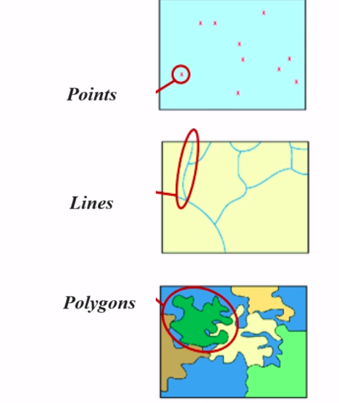

Slide 10
Applications of Spatial Data Mining
The following are some of the applications of spatial data mining:
Urban Planning
Spatial Data Mining is used by urban planners to analyze and improve urban dynamics. It can be used to enhance urban growth, improve transportation systems, and refine decisions about land.
Public Health
Spatial Data Mining plays an important role in public health research. It is used to develop strategies to identify diseases, track the spread of infections, and optimize healthcare resources.

Slide 11
Transportation
Spatial Data Mining can be used to identify traffic patterns, prevent congestion, manage the transportation network, and optimize transportation routes.
Environmental Management
Spatial Data Mining also contributes to environmental management by detecting changes in the environment, identifying the land at risk, conserving water and biodiversity, and monitoring natural resources.
Crime Analysis
Spatial Data Mining can be used to identify crime hotspots, understand crime patterns and develop proper strategies to prevent crimes and hence improve public safety.

