Slide 1
Stack Linked List
Terminology: Top, Node, Data, Next, NULL
Operations: push( ), pop( ), Display()

Slide 2
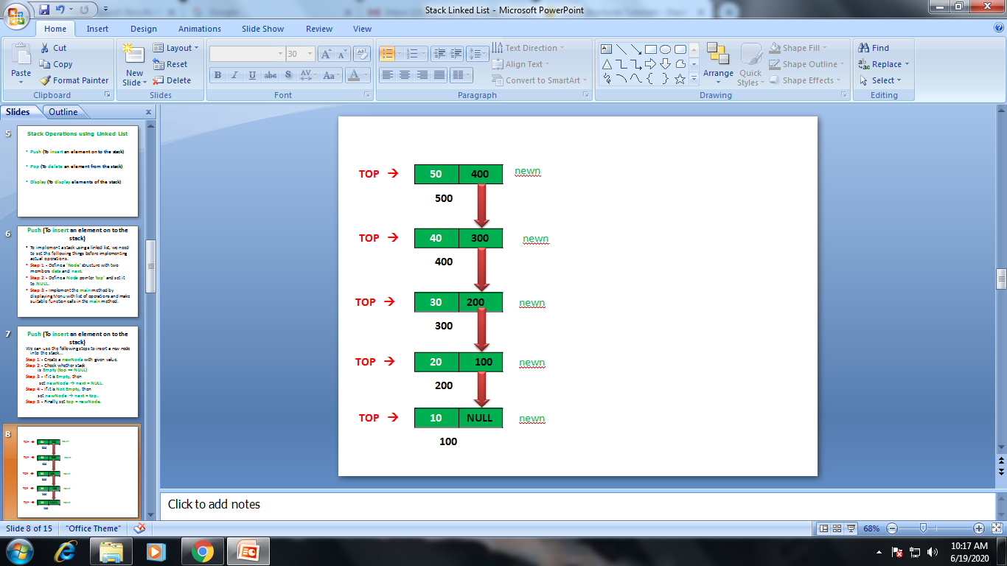
Stack Linked List
Top--->

Slide 3
content
Introduction
What is Stack Linked List?
Stack Operations using Linked List
Algorithm for Push()
Algorithm for Pop()
Algorithm for Display()
Coding
Output

Slide 4
Introduction
The major problem with the stack implemented using an array is, it works only for a fixed number of data values.
That means the amount of data must be specified at the beginning of the implementation itself.
Stack implemented using an array is not suitable, when we don't know the size of data which we are going to use.

Slide 5
What is Stack Linked List?
A stack data structure can be implemented by using a linked list data structure.
The stack implemented using linked list can work for an unlimited number of values.
In stack implemented using linked list, there is no need to fix the size at the beginning of the implementation.

Slide 6
What is Stack Linked List?
In linked list implementation of a stack, every new element is inserted at 'top' position.
Here every newly inserted element is pointed by 'top‘ variable.
If you want to remove an element from the stack, simply remove the node which is pointed by 'top' by moving 'top' to its previous node in the list.
The next field of the first element(node) should be always NULL.

Slide 7
Stack Operations using Linked List
Push (To insert an element on to the stack)
Pop (To delete an element from the stack)
Display (To display elements of the stack)

Slide 8
Structure of Node
To implement a stack using a linked list, we need to define the structure for node
Step 1 - Define a 'Node' structure with two members data and next.
Step 2 - Define a Node pointer 'top' and set it to NULL.

Slide 9
Node Structure
Structure Node
{
Int data;
Structure Node *Next;
}*top=NULL;
Data | Next
Node
100

Slide 10
Algorithm for Push Operation
We can use the following steps to insert a new node into the stack...
Step 1 - Create a newNode with given value.
set newNode → data = Value ;
Step 2 - Check whether stack is Empty (top == NULL)
Step 3 - If it is Empty, then
set newNode → next = NULL;.
Step 4 - If it is Not Empty, then
set newNode → next = top.
Step 5 - Finally, set top = newNode.

Slide 11
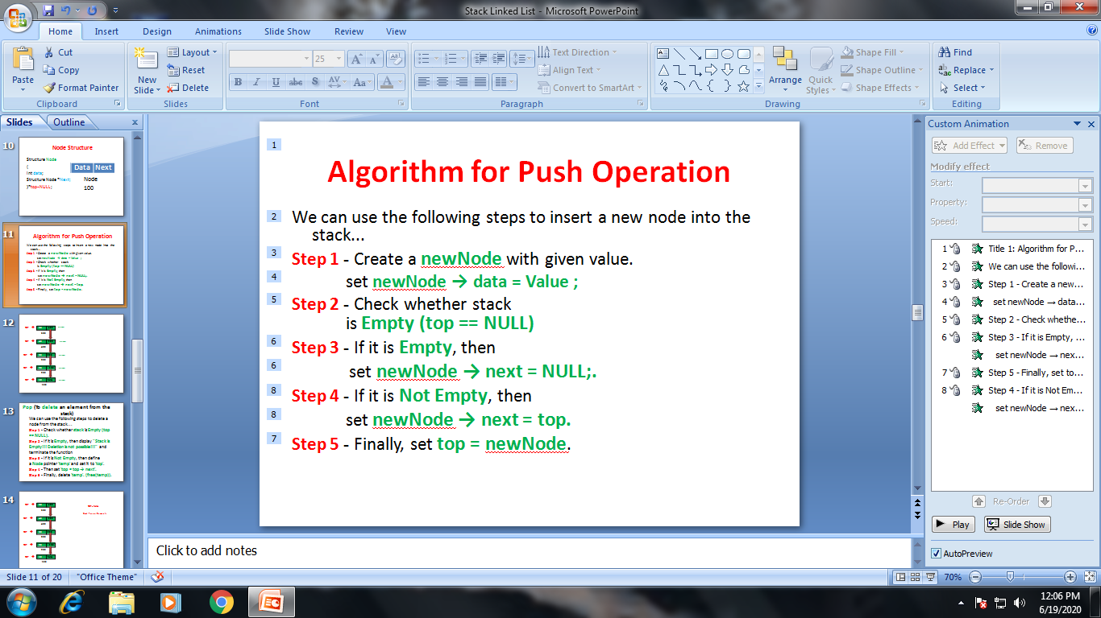
TOP →
50
newn
400
500
TOP →
40
300
newn
400
TOP →
30
200
newn
300
TOP →
20
100
newn
200
TOP →
10
NULL
newn
100

Slide 12
Pop (To delete an element from the stack)
We can use the following steps to delete a node from the stack...
Step 1 - Check whether stack is Empty (top == NULL).
Step 2 - If it is Empty, then display "Stack is Empty!!! Deletion is not possible!!!" and terminate the function
Step 3 - If it is Not Empty, then define a Node pointer 'temp' and set it to 'top'.
Step 4 - Then set 'top = top → next'.
Step 5 - Finally, delete 'temp'. (free(temp)).

Slide 13
TOP →
50
400
TOP=NULL
500
Stack has no Elements.
List is empty
TOP →
40
300
400
TOP →
30
200
300
TOP →
20
100
200
TOP →
10
NULL
100

Slide 14
Display (To display elements of the stack)
We can use the following steps to display the elements (nodes) of a stack...
Step 1 - Check whether stack is Empty (top == NULL).
Step 2 - If it is Empty, then display 'Stack is Empty!!!' and terminate the function.
Step 3 - If it is Not Empty, then define a Node pointer 'temp' and initialize with top.
Step 4 - Display 'temp → data --->' and move it to the next node. Repeat the same until temp reaches to the first node in the stack. (temp → next != NULL).
Step 5 - Finally! Display 'temp → data ---> NULL'.

Slide 15
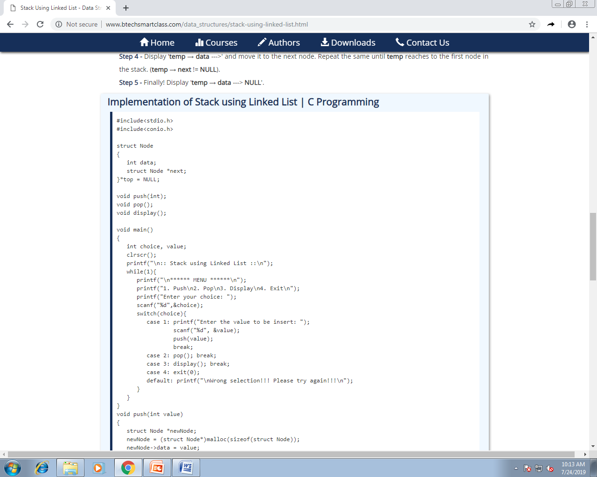
Code for Stack SLL

Slide 16
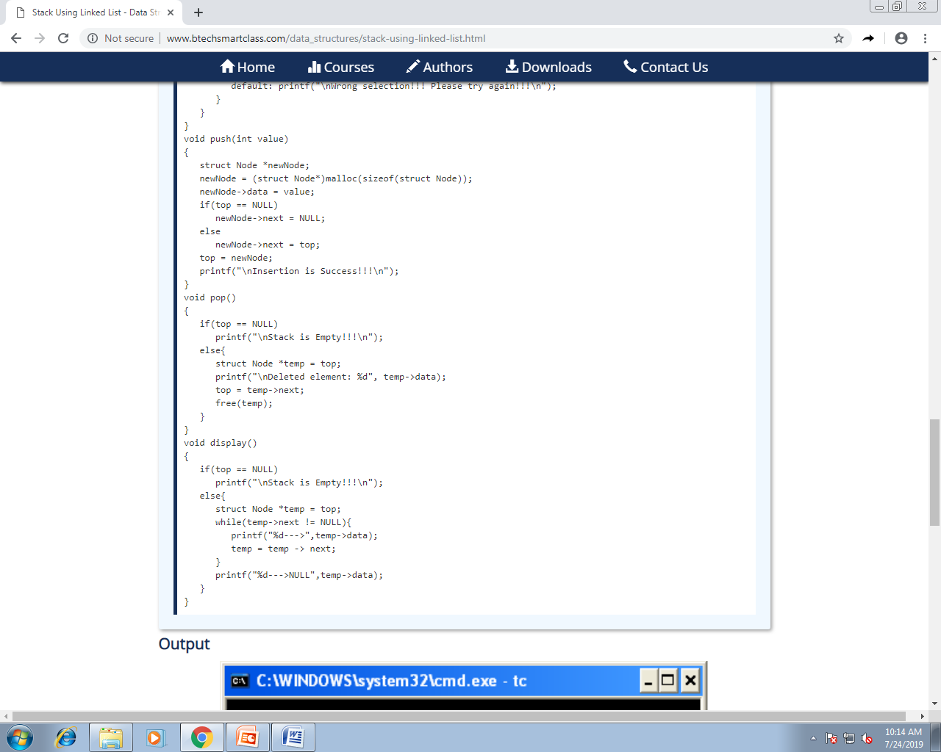

Slide 17
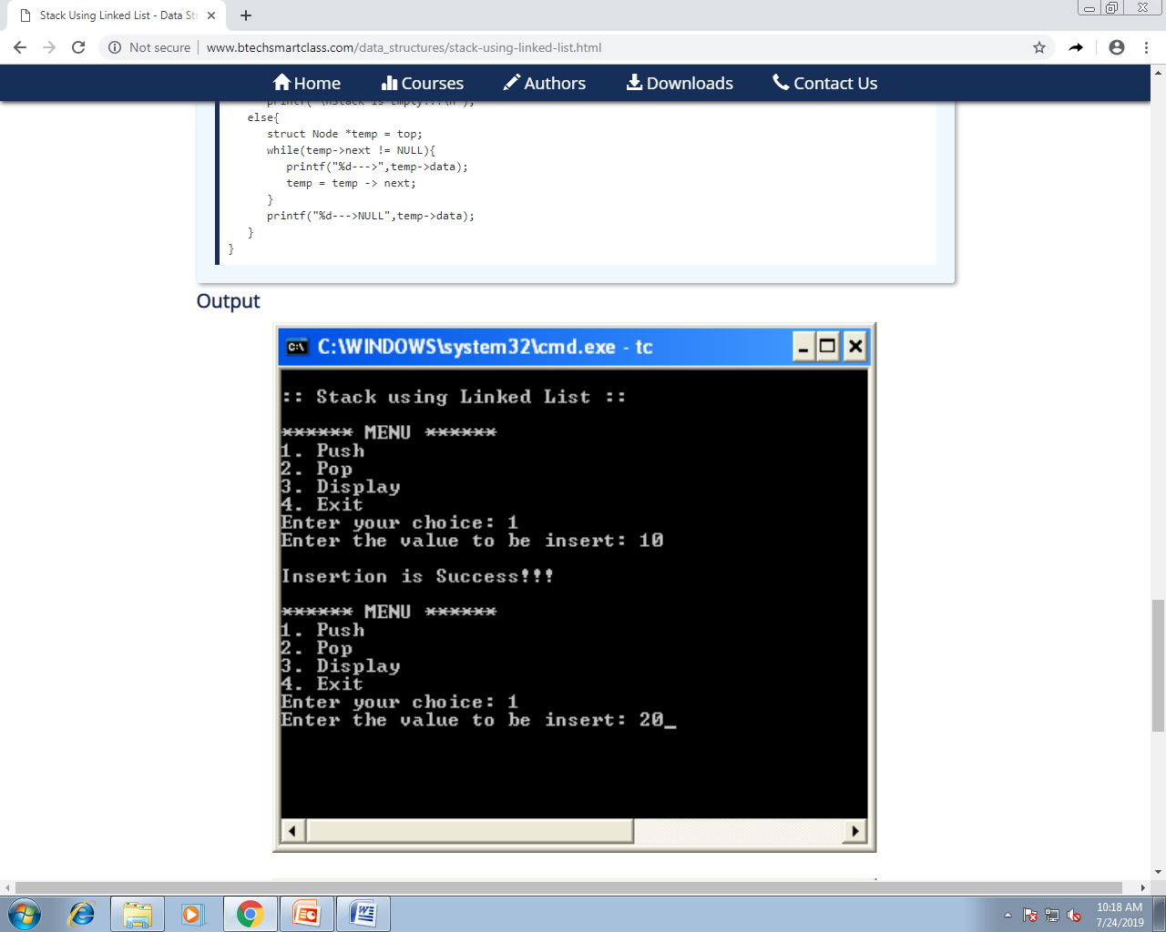
OUTPUT

Slide 18
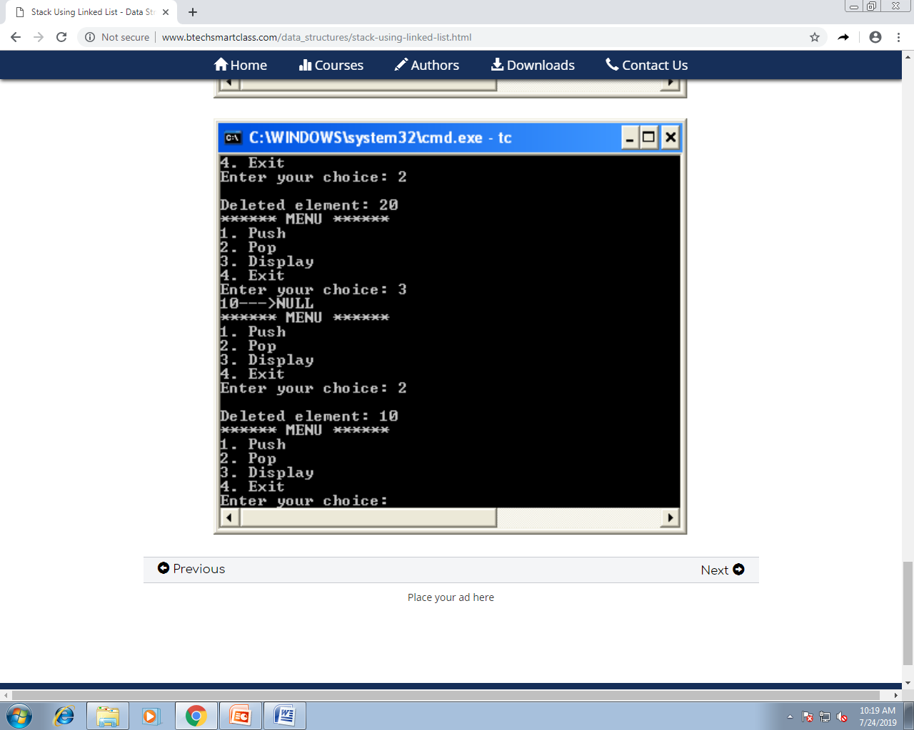

Slide 19
Thank You

