Slide 1
Text Mining
- extracting essential information from standard language text data.

Slide 2
What is Text Mining?
Text data mining can be described as the process of extracting essential data from standard language text.
All the data that we generate via :
  Text messages
  Text documents
  Emails
  Files
The primary source of data is e-commerce websites, social media platforms, published articles, survey, and many more.
The larger part of the generated data is unstructured, which makes it challenging and expensive for the organizations to analyze with the help of the people.

Slide 3
What is Text Mining?
Text mining, also referred to as text data mining, roughly equivalent to text analytics, is the process of deriving high-quality information from text.
Text mining uses natural language processing (NLP), allowing machines to understand the human language and process it automatically.
Natural language processing (NLP) is the ability of a computer program to understand human language as it is spoken and written. It is a component of artificial intelligence (AI).

Slide 4
Why is Text Mining Important?
Individuals and organizations generate tons of data every day. Stats claim that almost 80% of the existing text data is unstructured, meaning it’s not organized in a predefined way, it’s not searchable, and it’s almost impossible to manage. In other words, it’s just not useful.

Slide 5
How Does Text Mining Work?
Text mining helps to analyze large amounts of raw data and find relevant insights. Combined with machine learning, it can create text analysis models that learn to classify or extract specific information based on previous training.
The first step in text mining is collecting or gathering the data.
Data can be internal (interactions through chats, emails, surveys, spreadsheets, databases, etc) or external (information from social media, review sites, news outlets, and any other websites).

Slide 6
How Does Text Mining Work?
The second step is preparing(preprocessing) your data. Text mining systems use several NLP techniques ― like Segmentation, tokenization,lemmatization, stemming and stop removal ― to build the inputs of your machine learning model.

Slide 7
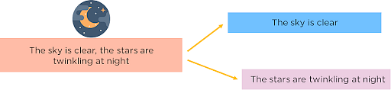
The steps to perform preprocessing of data :
Segmentation:
- Break the entire document/article into its component sentences by its punctuations like full stops and commas.

Slide 8
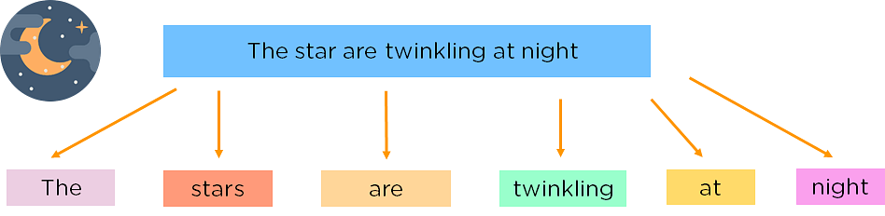
The steps to perform preprocessing of data :
Tokenizing:
- Tokenization is a process of splitting a text / sentence into smaller units(words) which are also called tokens.

Slide 9
The steps to perform preprocessing of data :
Stemming:
- Stemming is a technique used to extract the base form of the words by removing affixes from them. For example, the stem of the words eating, eats, eaten is eat.
Lemmatization:
- Lemmatization considers the context and converts the word to its meaningful base form, which is called Lemma. For instance, stemming the word 'Caring' would return 'Car'. For instance, lemmatizing the word 'Caring' would return 'Care'.

Slide 10
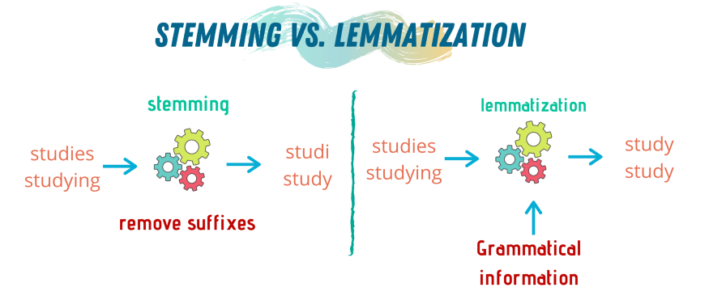
The steps to perform preprocessing of data :

Slide 11
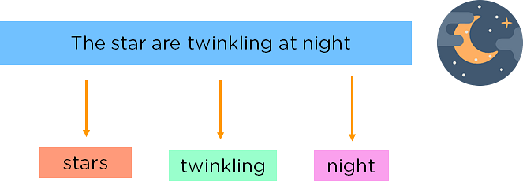
The steps to perform preprocessing of data :
Filtering (or) Removing Stop Words:
- It is a process of removing non-essential words,i.e Words such as was, in, is, and, the, are called stop words and can be removed.

Slide 12
How Does Text Mining Work?
The third step is Feature Extraction form pre processed data.
The mapping from textual data to real-valued vectors is called feature extraction.
One of the commonly used technique to extract the features from textual data is calculating the frequency of words/tokens in the document/corpus.

Slide 13
Bag of Words (BOW)
One of the simplest technique is Bag of Words (BOW) to represent the text in numerical format(Vectors).
In BOW, we make a list of unique words in the text corpus called vocabulary. Then we can represent each sentence or document as a vector, with each word represented as 1 for presence and 0 for absence.
The bag-of-words (BOW) model is a representation that turns arbitrary text into fixed-length vectors by counting how many times each word appears. This process is often referred to as vectorization.

Slide 14
Bag of Words (BOW)
Let’s understand this with an example. Suppose we wanted to vectorize the following:
Document 1 : the cat sat
Document 2: the cat sat in the hat
Document 3: the cat with the hat
Step 1: Determine the Vocabulary
We first define our vocabulary, which is the set of all unique words found in our document set.
The Words are :
the, cat, sat, in, hat, with

Slide 15
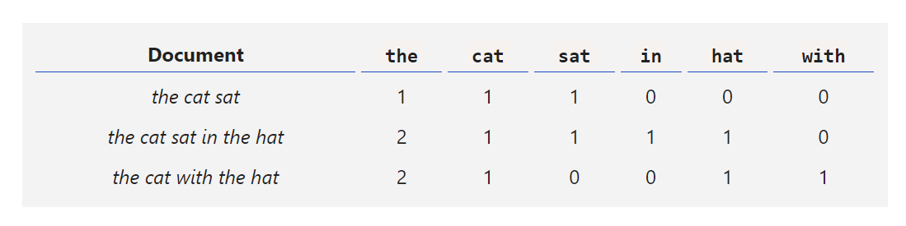
Bag of Words (BOW)
Step 2: Count

Slide 16
Bag of Words (BOW)
Step 3: Vector Representation
Now we have length-6 vectors for each document.
the cat sat: [1, 1, 1, 0, 0, 0]
the cat sat in the hat: [2, 1, 1, 1, 1, 0]
the cat with the hat: [2, 1, 0, 0, 1, 1]
- Notice that we lose contextual information, e.g. where in the document the word appeared, when we use BOW. It’s like a literal bag-of-words: it only tells you what words occur in the document, not where they occurred.

Slide 17
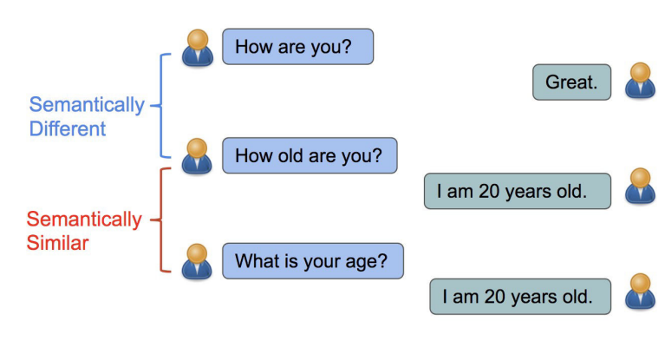
-Term frequency — Inverse document frequency (TFIDF)
-Word2Vec (W2V)

Slide 18
