Slide 1
Web Mining
- Discovering interesting and useful information from Web content and usage data

Slide 2
What is Web Mining?
Web mining is a data mining technique to extract knowledge from web data.
Web data includes :
  web documents
  hyperlinks between documents
  usage logs of web sites
The WWW is huge, widely distributed, global information service centre and, therefore, It is a rich source for data mining.

Slide 3
World Wide Web
  There are about 1.5 billion websites.
  But less than 400 million are active.
  Grows at about 1 million pages a day
  By the time you finish this class, thousands of new sites will spawn.
  Lots of duplication (70-80%)
What is the most visited site in the world?
Go ahead — Google it!
Fun fact:
More than 80% of all Google searches are initiated by the Google staff,
in the process of developing and refining its search algorithms.

Slide 4
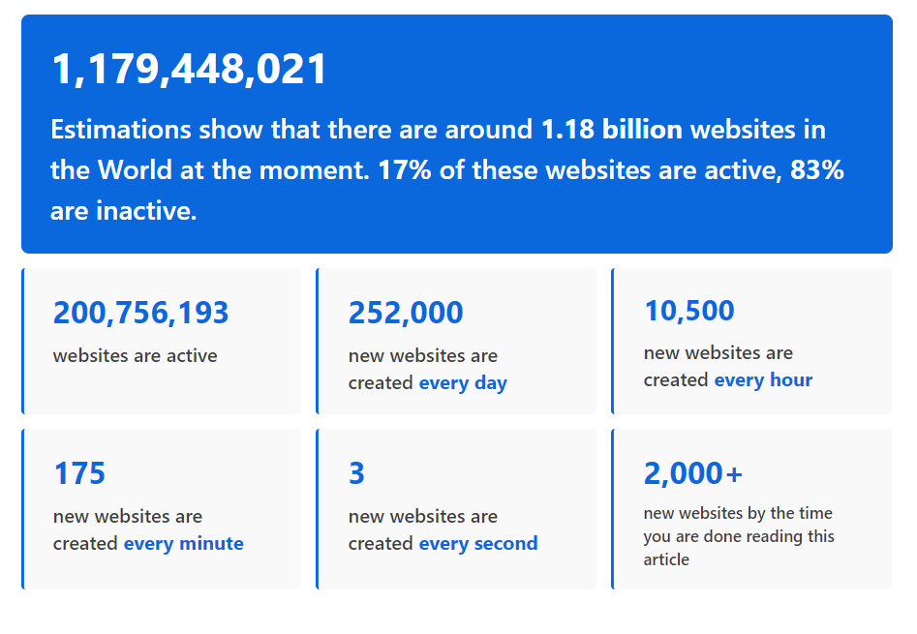
How Many Websites Are There in the World

Slide 5
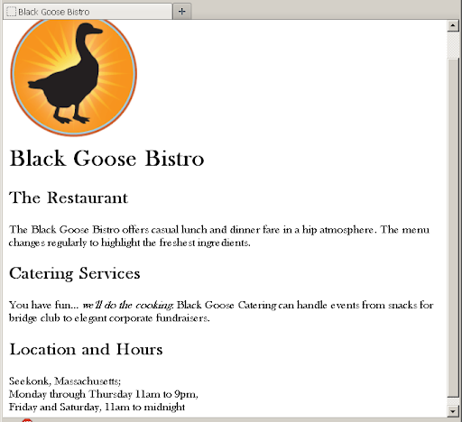
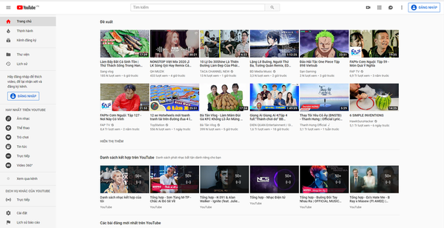
World Wide Web
Diverse types of data
  Text
  Images
  Audio & Video

Slide 6
Web Mining
Web mining is the application of data mining techniques to discover useful information from the World Wide Web.
It uses automated methods to extract both structured and unstructured data from web pages, server logs and link structures.

Slide 7
Web Mining
Examples:
Web search, e.g. Google, Yahoo, Bing, Dogpile ,Duck Duck Go Ecosia ,Gigablast ,…
Specialized search: e.g. Squool Tube - Search for factual, educational videos., Elephind - search the world's historical newspaper archives.
eCommerce : e.g. Amazon,Flipkart,eBay,Fiverr,Upwork.
  Advertising, e.g. Google Adsense
Improving Web site design and performance

Slide 8
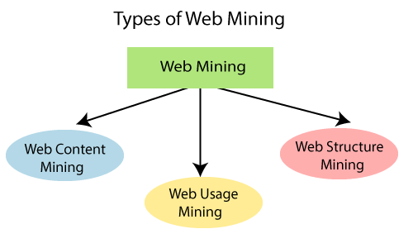
Web Mining

Slide 9
Web Content Mining
Web content mining can be used to extract useful data, information, knowledge from the web page content.
In web content mining, each web page is considered as an individual document.
The primary task of content mining is data extraction, where structured data is extracted from unstructured websites.

Slide 10
Web Content Mining
Web content mining can be utilized to distinguish topics on the web.
For Example, if any user searches for a specific book on the search engine, then the user will get a list of suggestions.
The technologies that are normally used in web content mining are NLP (Natural language processing) and IR (Information Retrieval).
Techniques in Web Content Mining :
  Classification
  Clustering

Slide 11
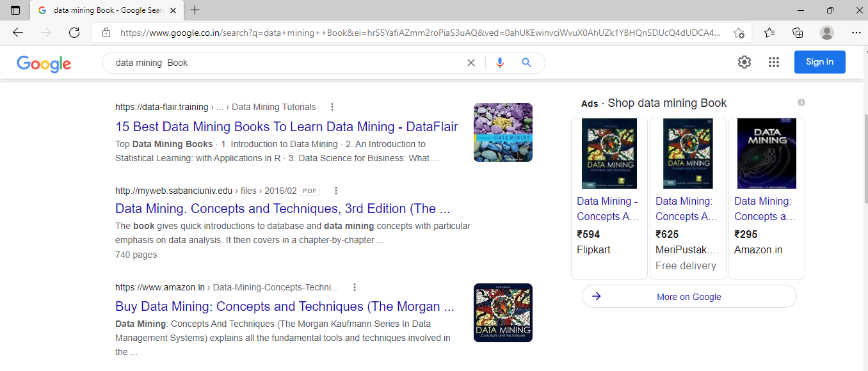
Web Content Mining

Slide 12
Web Usage Mining
Web usage mining is the application of identifying or discovering interesting usage patterns from large data sets.
And these patterns enable you to understand the user behaviors or something like that.
Web usage mining is used for mining the web log records (access information of web pages) and helps to discover the user access patterns of web pages.
Web server registers a web log entry for every web page.

Slide 13
Web Usage Mining
The main source of data here is Web Server and Application Server.
Log files are created when a user/customer interacts with a web page.
Techniques in Web Usage Mining :
  Association Rules
  Classification
  Clustering

Slide 14
Web Usage Mining
Advantage:
This technology has enabled e-commerce to do personalized marketing, which eventually results in higher trade volumes.
Disadvantage:
This technology when used on data of personal nature might cause concerns. The most criticized ethical issue involving web usage mining is the invasion of privacy.

Slide 15
Web Structure Mining
Web structure mining is the application of discovering structure information from the web.
The structure of the web graph consists of web pages as nodes, and hyperlinks as edges connecting related pages.
Structure mining basically shows the structured summary of a particular website. It identifies relationship between web pages linked by information or direct link connection.
Techniques in Web Structure Mining :
  Association Rules
  Classification

Slide 16
Web Structure Mining
Example:
The most important application in this regard is the Google search engine, which estimates the ranking of its outcomes primarily with the PageRank algorithm.
The rank of a page is decided by the number and quality of links pointing to the target node.
In general, Web structure mining can be very useful to companies to determine the
connection between two commercial websites.

Slide 17
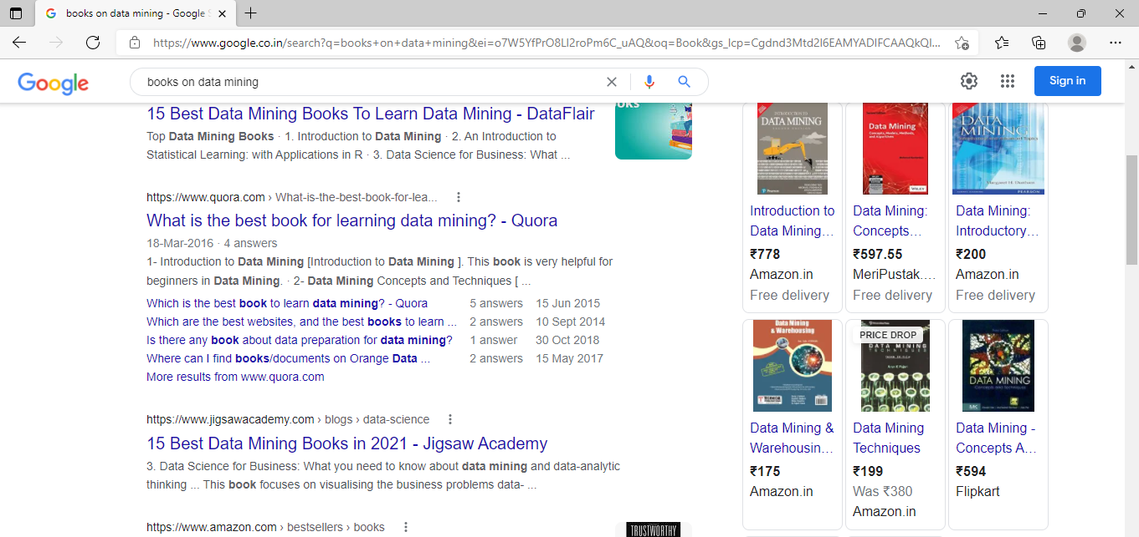
Web Structure Mining

Slide 18
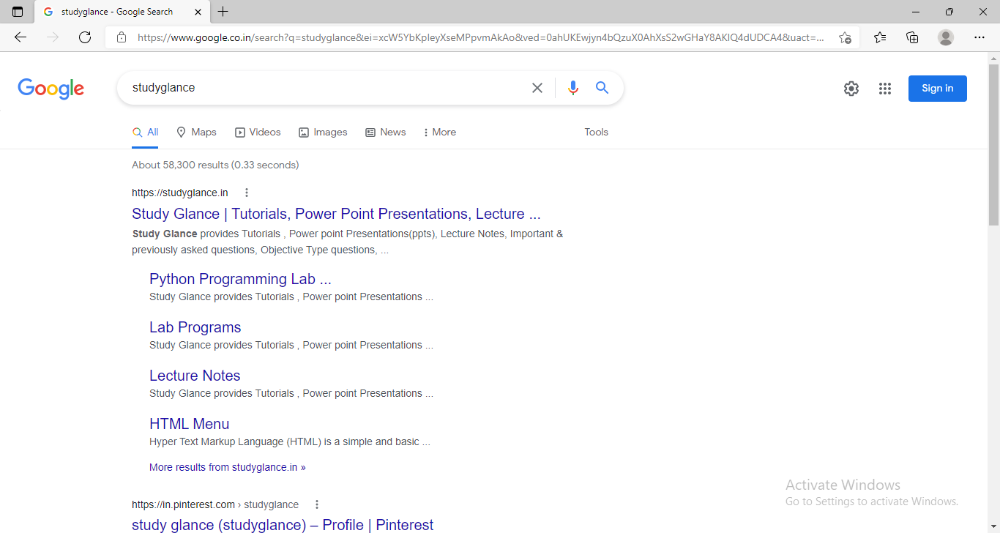
Web Structure Mining

